Slide 1
Custom Linked Data Structures
Chapter 19 of Visual C# How to Program, 6/e

Slide 2
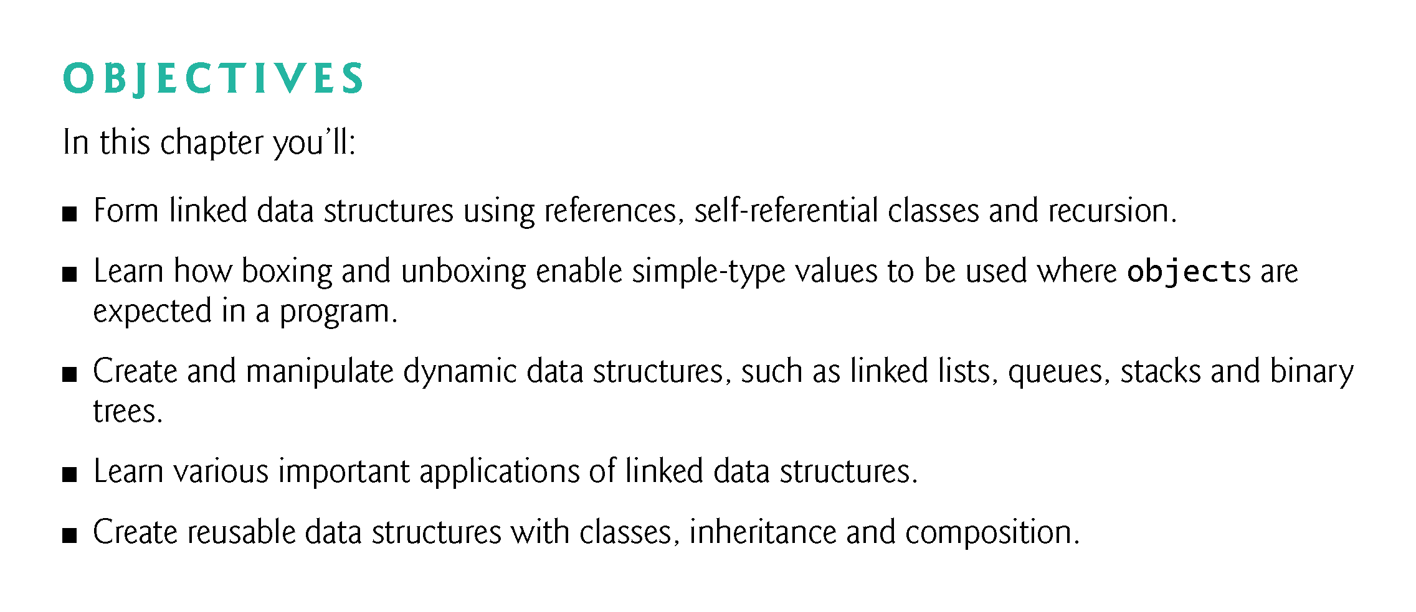
Static/dynamic structure!!!

Slide 3
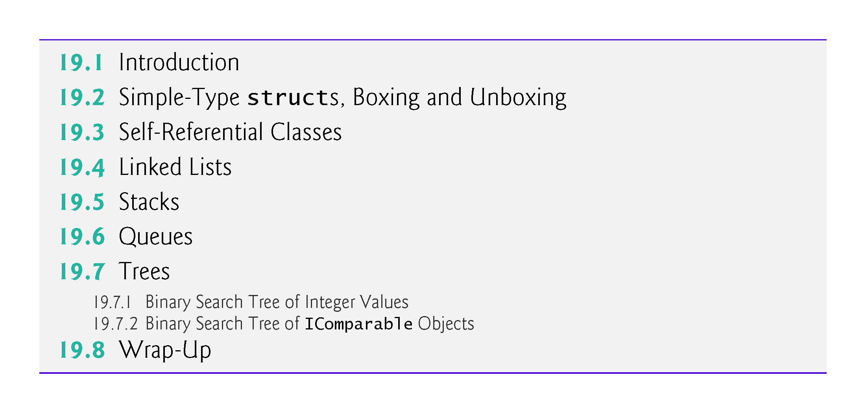

Slide 4
19.1 Introduction
This chapter enhances our discussion of dynamic data structures that grow and shrink at execution time. （diff from array-static data type）
Linked lists are collections of data items “lined up in a row” or “chained together”—users can make insertions and deletions anywhere in a linked list. （insert and delete at anywhere!!!）
Stacks are important in compilers and operating systems; insertions and deletions are made at only one end—its top. （insert and delete at only one end!!!）
!!!

Slide 5
19.1 Introduction (cont.)
Queues represent waiting lines; insertions are made at the back (also referred to as the tail) of a queue, and deletions are made from the front (also referred to as the head) of a queue. （insert at one end and delete at another end!!!）
Binary trees facilitate high-speed searching and sorting of data, efficient elimination of duplicate data items, representation of file-system directories and compilation of expressions into machine language.
These data structures have many other interesting applications as well.
!!!
!!!

Slide 6
19.2 Simple-Type structs, Boxing and Unboxing
Simple-Type structs
Each simple type (see Appendix B, Simple Types) has a corresponding struct in namespace System that defines the simple type.
These structs are called Boolean, Byte, SByte, Char, Decimal, Double, Single, Int16, UInt16 Int32, UInt32, Int64 and UInt64.
Types declared with keyword struct are value types.
Diff simple type, value type, struct!!!
Diff complex type, reference type, class/object!!!
!!!
!!!

Slide 7
19.2 Simple-Type structs, Boxing and Unboxing Cont.)
!!!
Simple types are actually aliases for their corresponding structs, so a variable of a simple type can be declared using either the keyword for that simple type or the struct name—e.g., int and Int32 are interchangeable. ??
The methods related to a simple type are located in the corresponding struct (e.g., method Parse, which converts a string to an int value, is located in struct Int32??).
!!!

Slide 8
19.2 Simple-Type structs, Boxing and Unboxing Cont.)
Boxing and Unboxing Conversions
Simple types and other structs inherit from class ValueType in namespace System. Class ValueType inherits from class object.
Thus, any simple-type value can be assigned to an object variable; this is referred to as a boxing conversion and enables simple types to be used anywhere objects are expected. (dog → animal)
In a boxing conversion, the simple-type value is copied into an object so that the simple-type value can be manipulated as an object.
!!!
!!!
Notes:
https://www.albahari.com/valuevsreftypes.aspx

Slide 9
19.2 Simple-Type structs, Boxing and Unboxing Cont.) P
Boxing conversions can be performed either explicitly or implicitly as shown in the following statements:
int i = 5; // create an int value
object object1 = ( object ) i; // explicitly box the int value
object object2 = i; // implicitly box the int value
After executing the preceding code, both object1 and object2 refer to two different objects that contain a copy of the integer value in int variable i.
An unboxing conversion can be used to explicitly convert an object reference to a simple value, as shown in the following statement:
int int1 = ( int ) object1; // explicitly unbox the int value
Explicitly attempting to unbox an object reference that does not refer to the correct simple value type causes an InvalidCastException.??
!!!
!!!

Slide 10
Boxing & Unboxing
boxing in C# is the process of converting a value type to a reference type, which involves allocating a new object on the heap and copying the value into it.
Unboxing is the reverse process, where a value is extracted from an object reference back into a value type through an explicit cast.

Slide 11
19.3 Self-Referential Classes
A self-referential class contains a reference member that refers to an object of the same class type.
For example, the class declaration in Fig. 19.1 defines the shell of a self-referential class named Node.
This type has two properties—int Data and Node reference Next.
Next references an object of type Node, an object of the same type as the one being declared here—hence, the term “self-referential class.”
Next is referred to as a link (i.e., Next can be used to “tie” an object of type Node to another object of the same type).

Slide 12
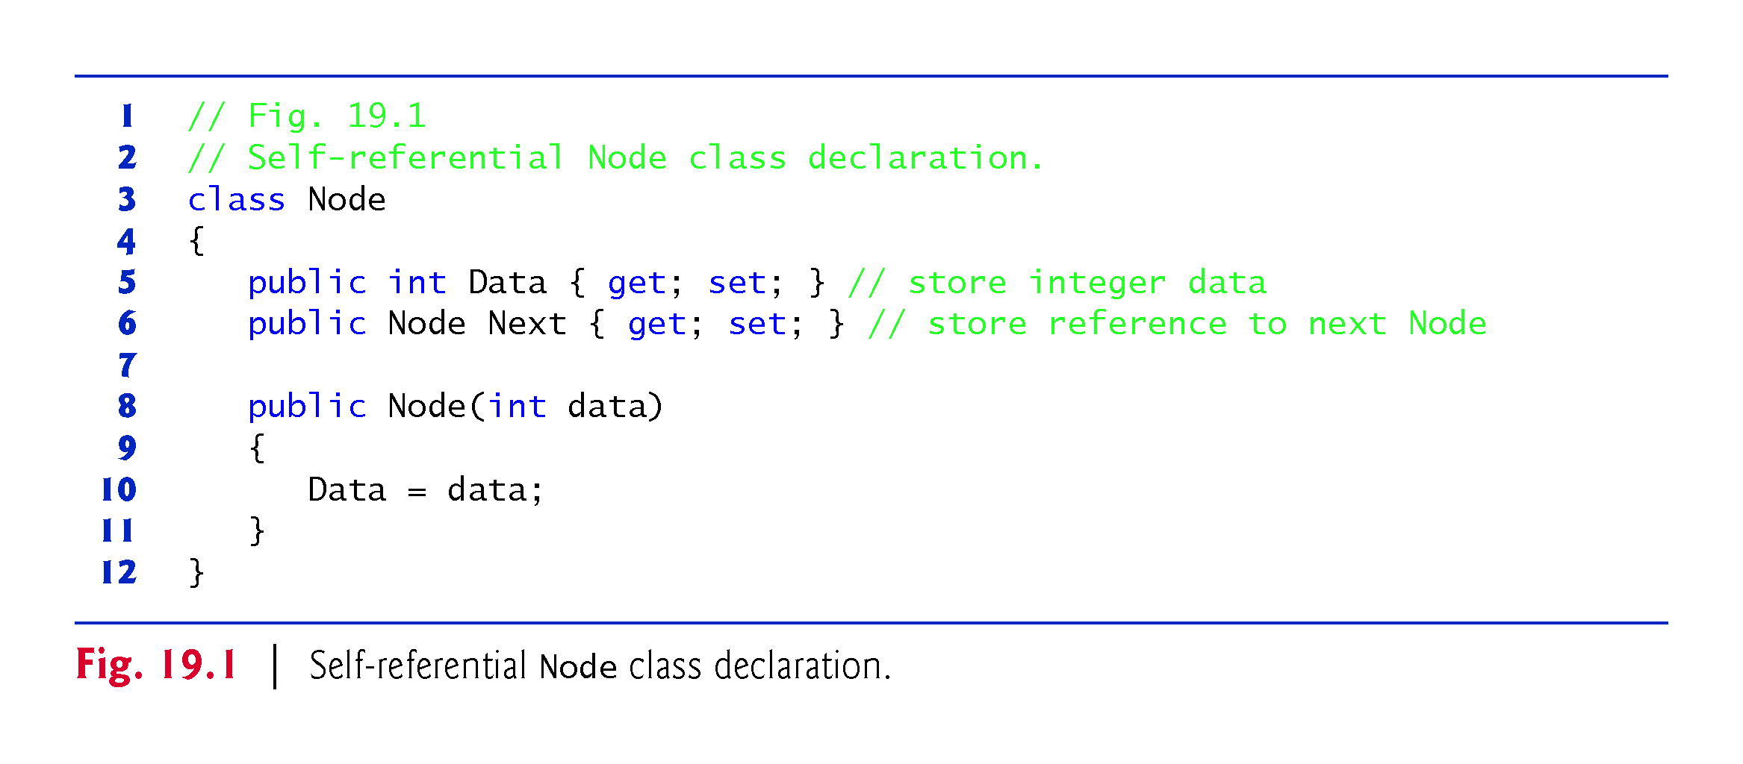

Slide 13
19.3 Self-Referential Classes (Cont.)
Figure 19.2 illustrates two self-referential objects linked together to form a linked list.
A backslash (representing a null reference) is placed in the link member of the second self-referential object to indicate that the link does not refer to another object.
The backslash is for illustration purposes; it does not correspond to the backslash character in C#.
A null link normally indicates the end of a data structure.

Slide 14
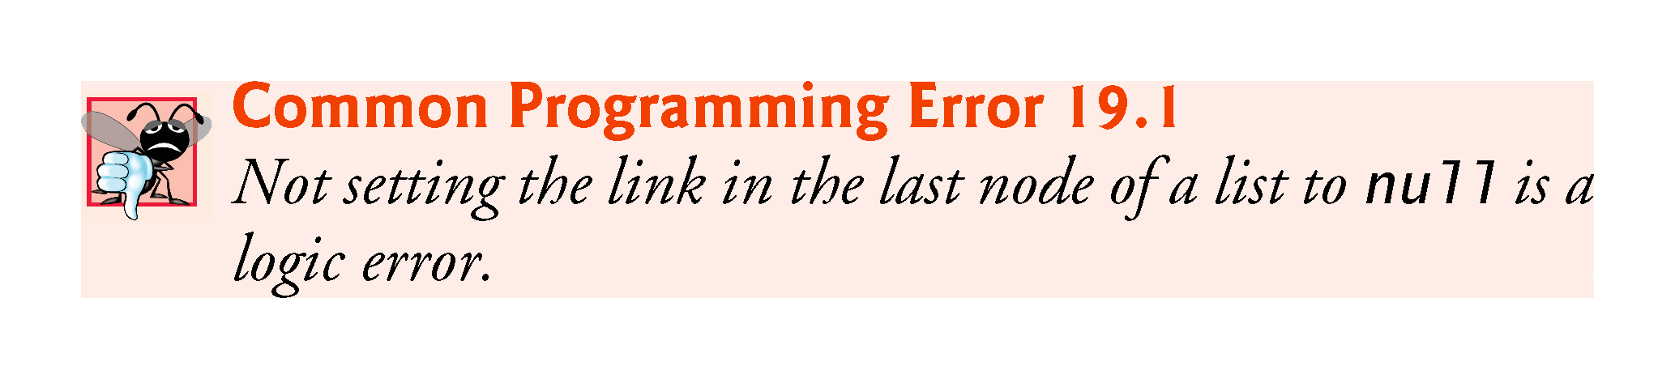

Slide 15
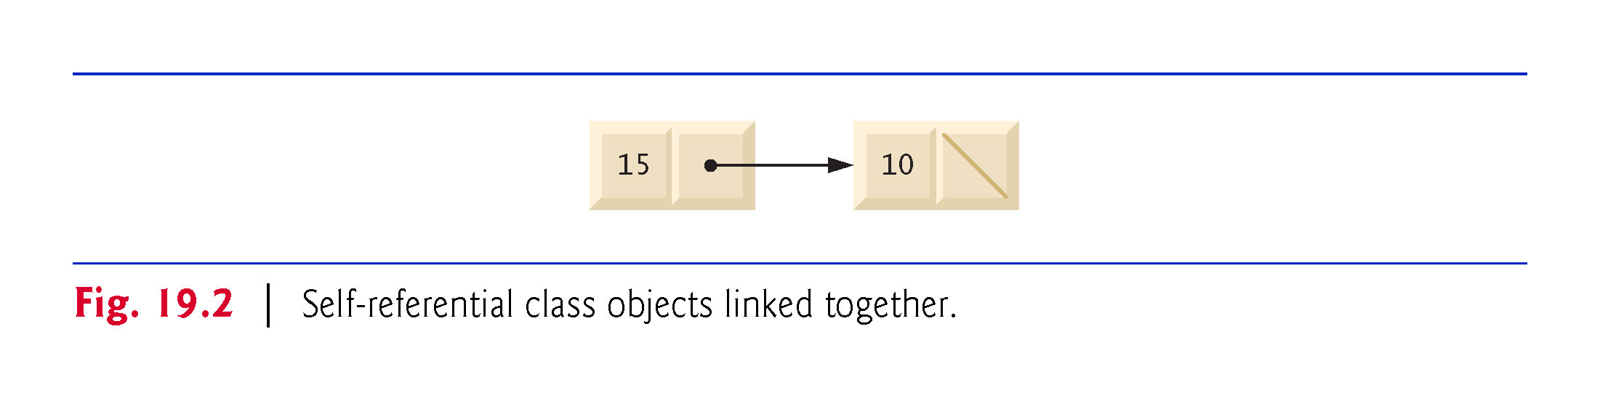

Slide 16
19.3 Self-Referential Classes (Cont.)
Creating and maintaining dynamic data structures requires dynamic memory allocation—a program’s ability to obtain more memory space at execution time to hold new nodes and to release space no longer needed.
The new operator is essential to dynamic memory allocation.
Operator new takes as an operand the type of the object being dynamically allocated and returns a reference to an object of that type.
For example, the statement
Node nodeToAdd = new Node( 10 );
allocates the appropriate amount of memory to store a Node, initializes it and stores a reference to this object in nodeToAdd.
If no memory is available, new throws an OutOfMemoryException.
The constructor argument 10 specifies the Node object’s data.

Slide 17
19.4 Linked Lists
A linked list is a linear collection (i.e., a sequence) of self-referential class objects, called nodes, connected by reference links—hence, the term “linked” list.
A program accesses a linked list via a reference to the first node of the list.
Each subsequent node is accessed via the link-reference member stored in the previous node. ??
By convention, the link reference in the last node of a list is set to null to mark the end of the list.

Slide 18
19.4 Linked Lists (cont.)
Data is stored in a linked list dynamically—that is, each node is created as necessary.
A node can contain data of any type, including references to objects of other classes.
Stacks and queues are also linear data structures—in fact, they may be viewed as constrained versions of linked lists.
Trees are nonlinear data structures.
!!!
!!!

Slide 19
19.4 Linked Lists (cont.)
Lists of data can be stored in arrays, but linked lists provide several advantages.
A linked list is appropriate when the number of data elements to be represented in the data structure is unpredictable.
Unlike a linked list, the size of a conventional C# array cannot be altered, because the array size is fixed at creation time.
Conventional arrays can become full, but linked lists become full only when the system has insufficient memory to satisfy dynamic memory allocation requests.
!!!
!!!
!!!
!!!

Slide 20
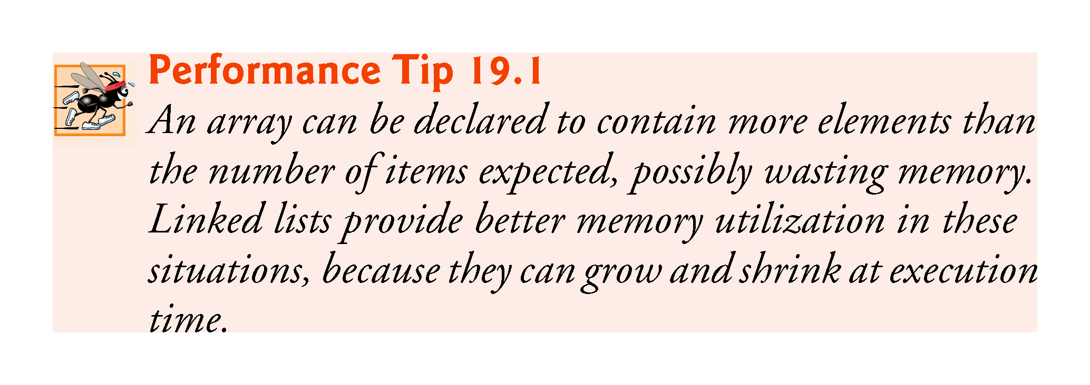
!!!

Slide 21
19.4 Linked Lists (cont.)
Programmers can maintain linked lists in sorted order simply by inserting each new element at the proper point in the list (locating the proper insertion point does take time).
They do not need to move existing list elements.
Normally linked-list nodes are not stored contiguously in memory.
Rather, the nodes are logically contiguous.
Figure 19.3 illustrates a linked list with several nodes.
!!!

Slide 22
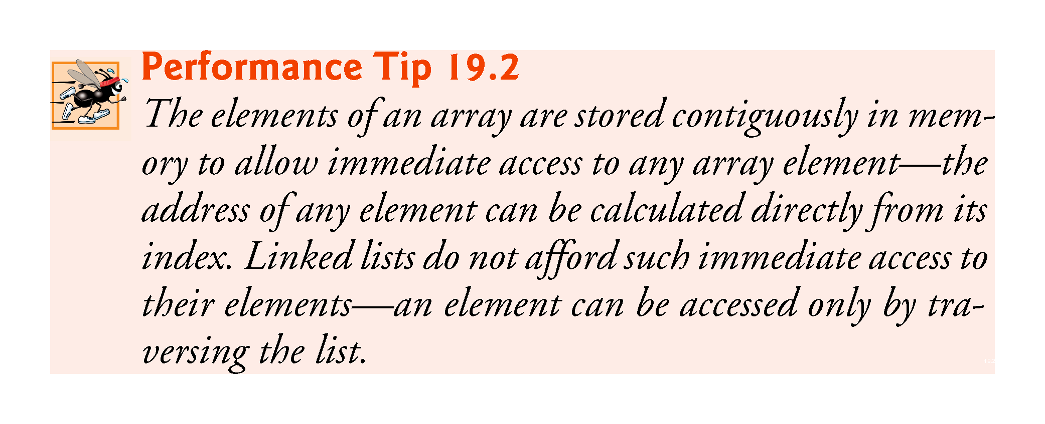
P
!!!

Slide 23
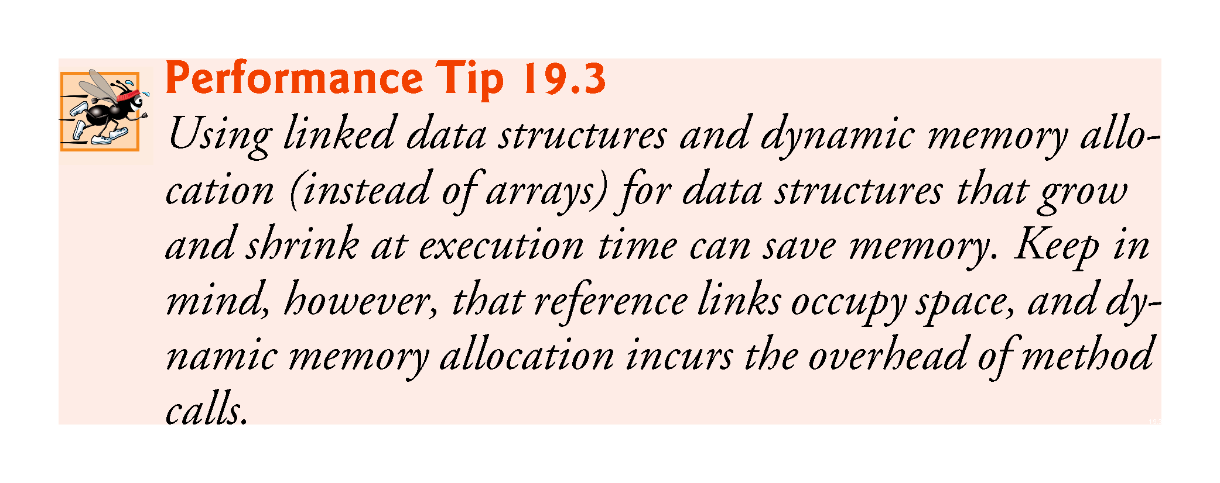
!!!

Slide 24
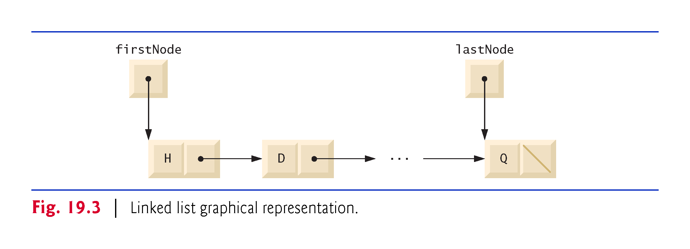

Slide 25
19.4 Linked Lists (cont.)
Linked-List Implementation
Figures 19.4–19.5 use an object of our List class to manipulate a list of miscellaneous object types.

Slide 26
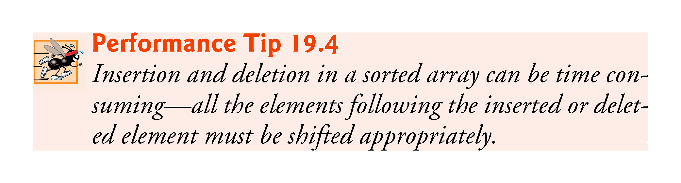
p
!!!

Slide 27
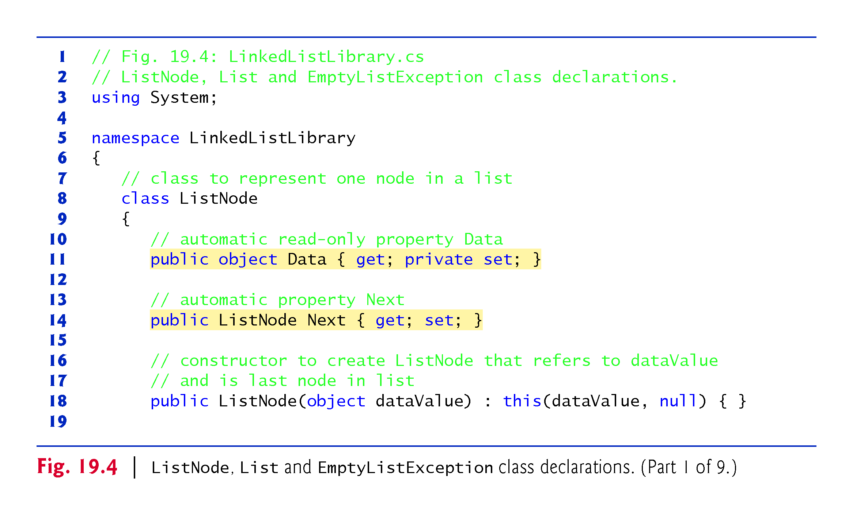
??

Slide 28
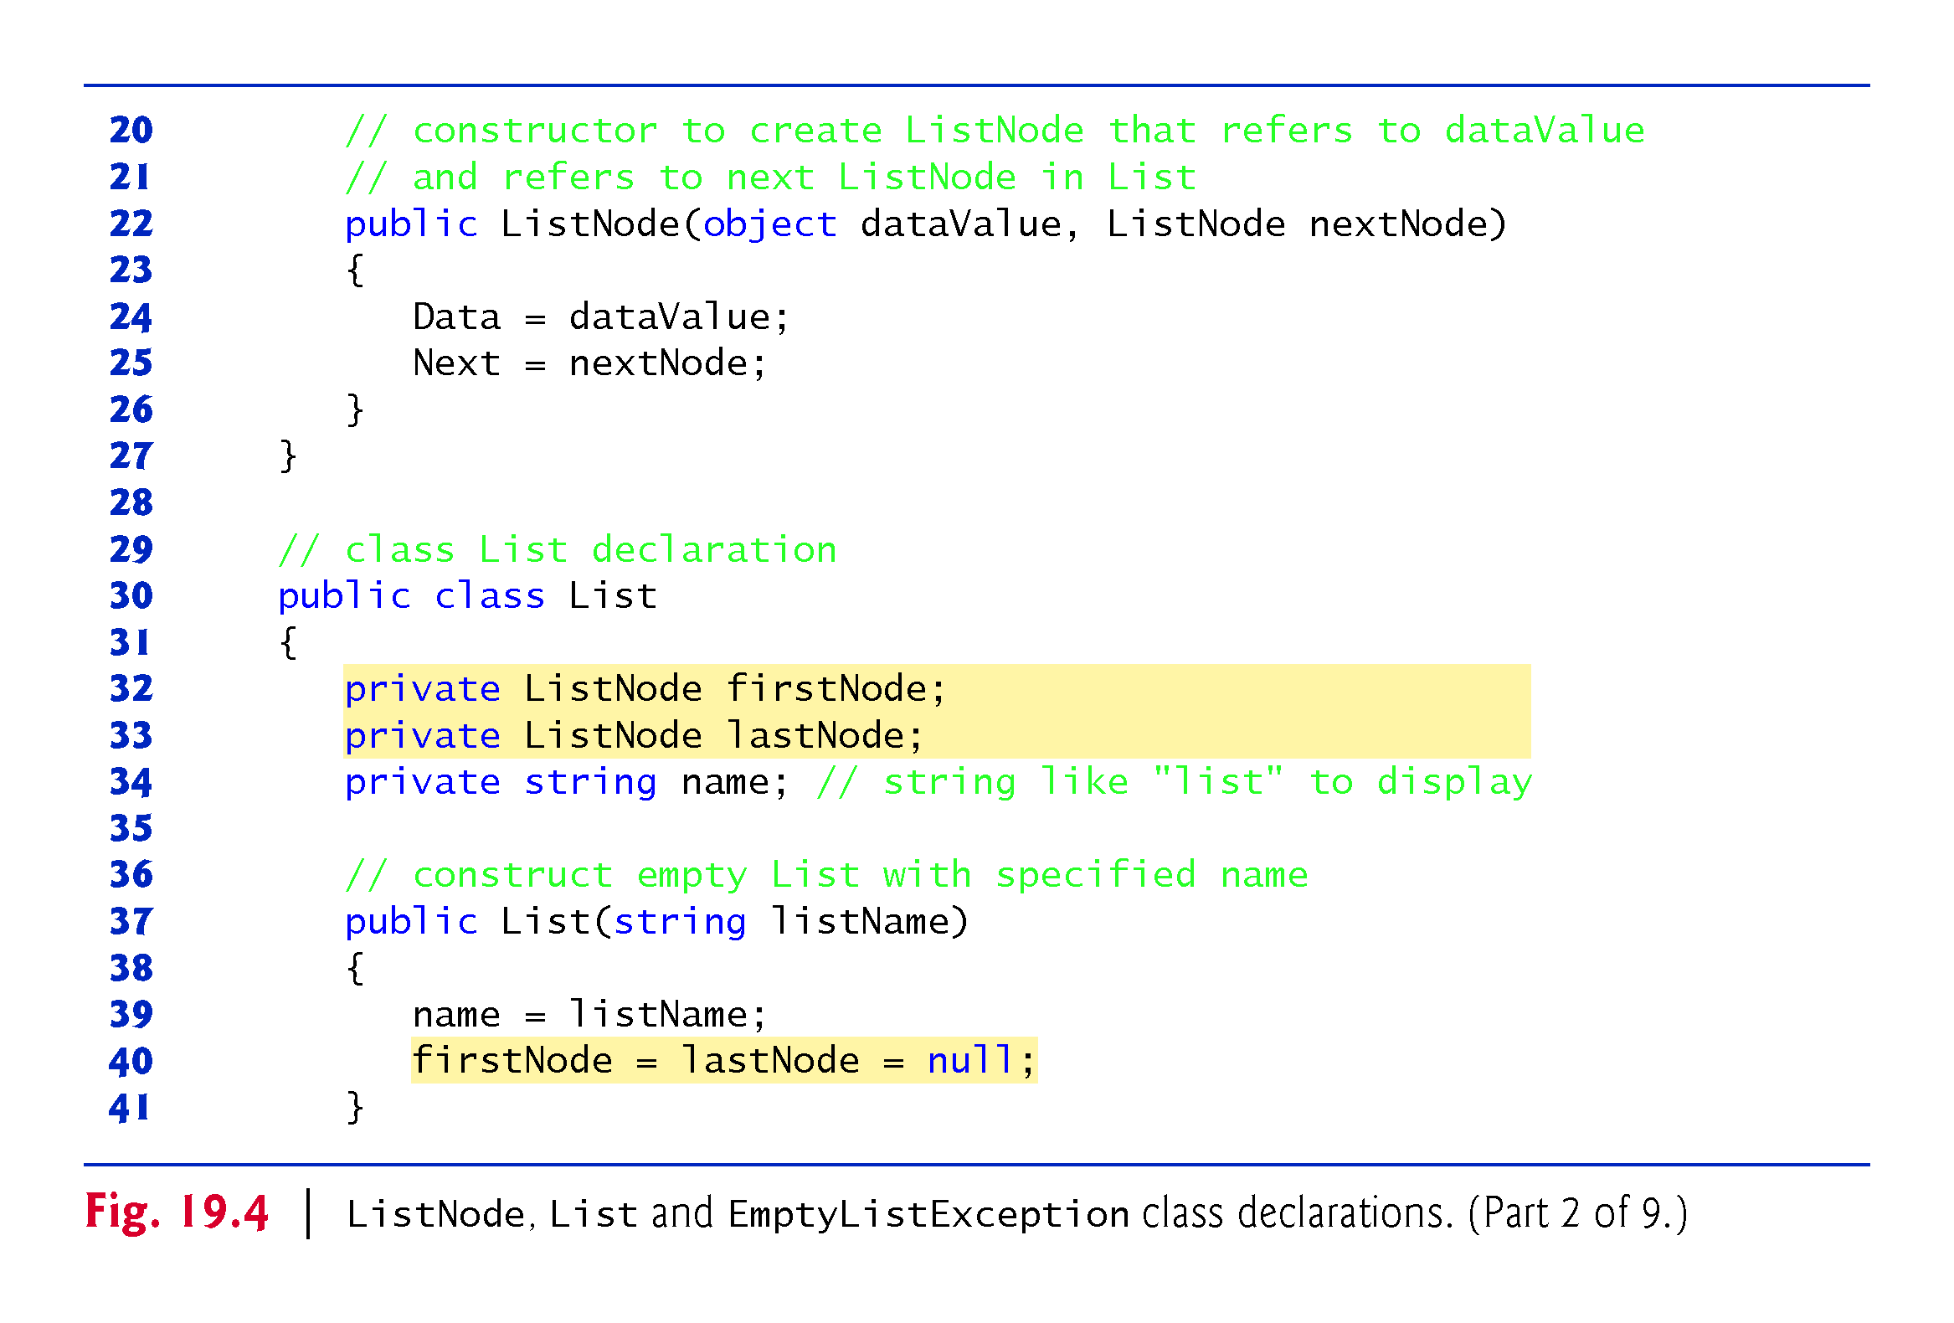

Slide 29
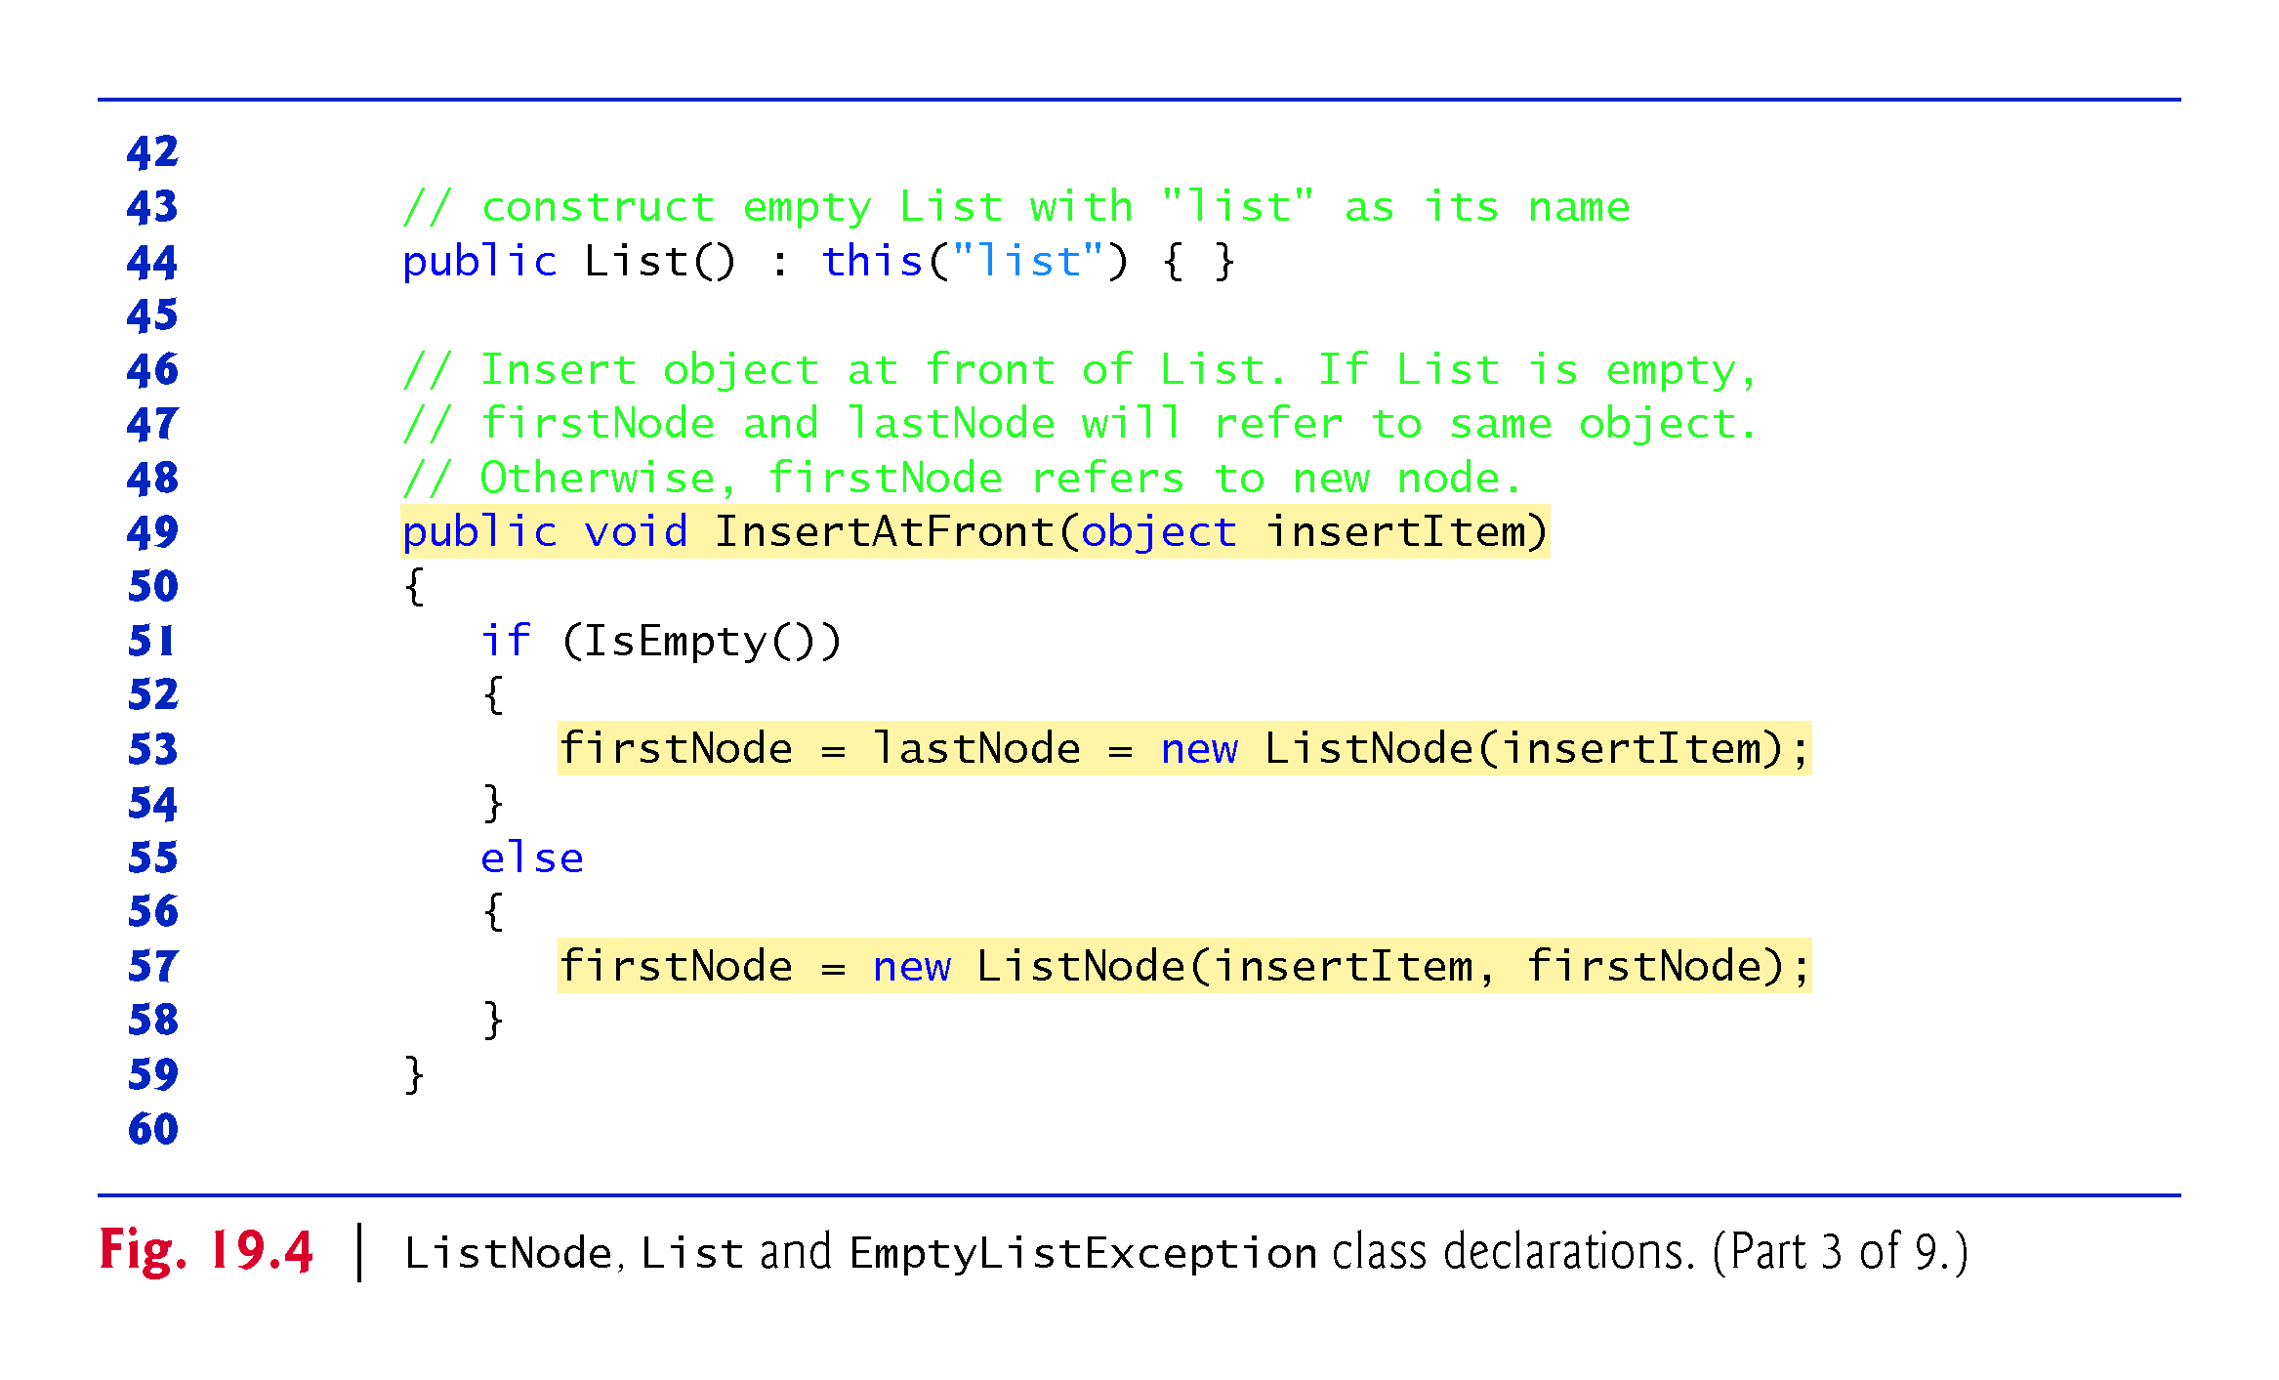

Slide 30
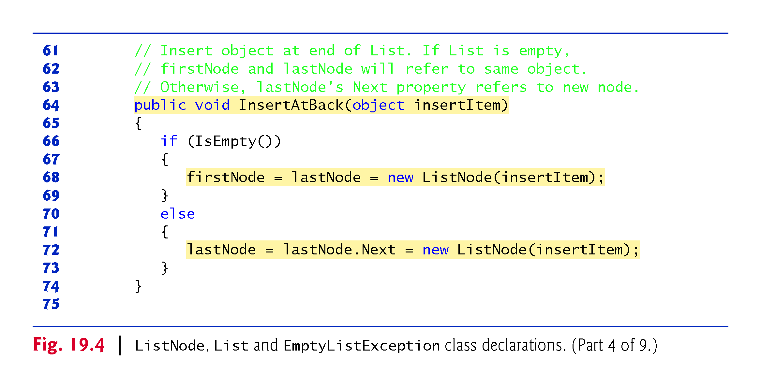

Slide 31
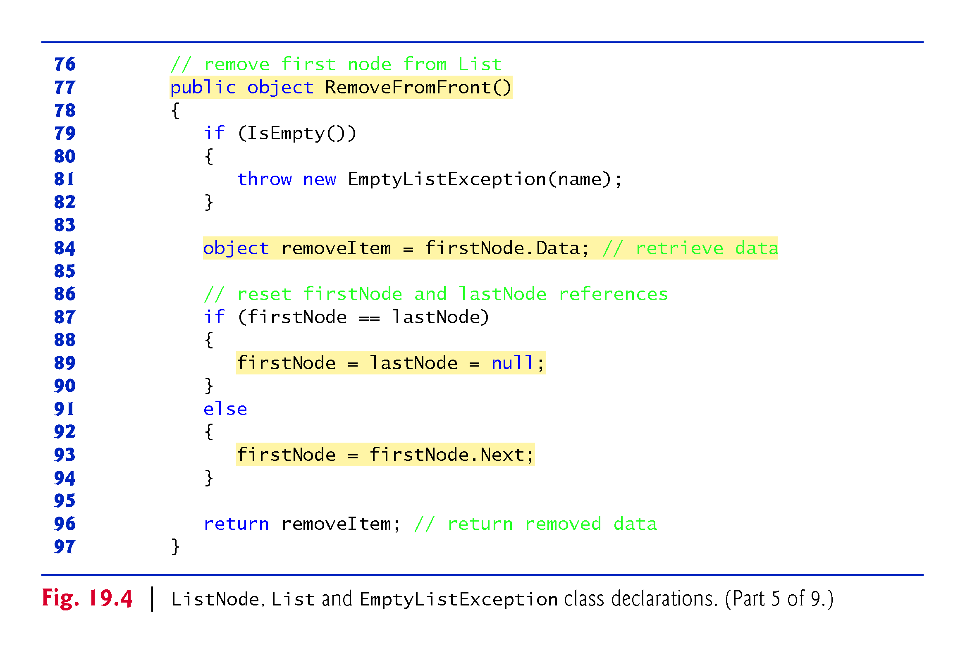

Slide 32
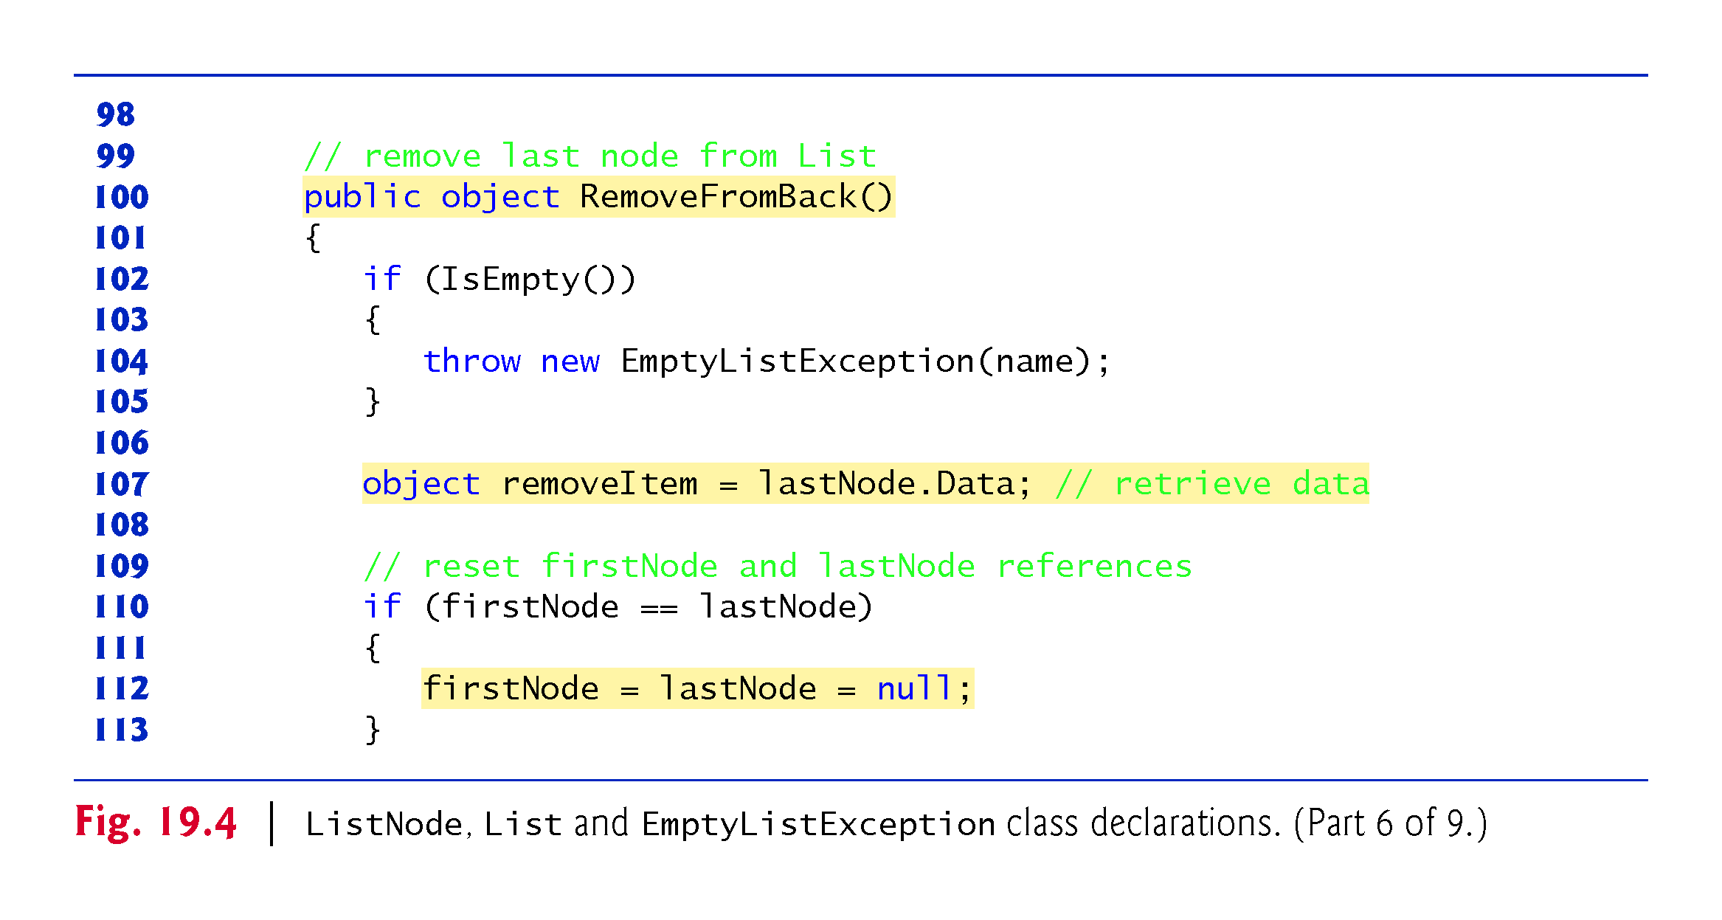

Slide 33
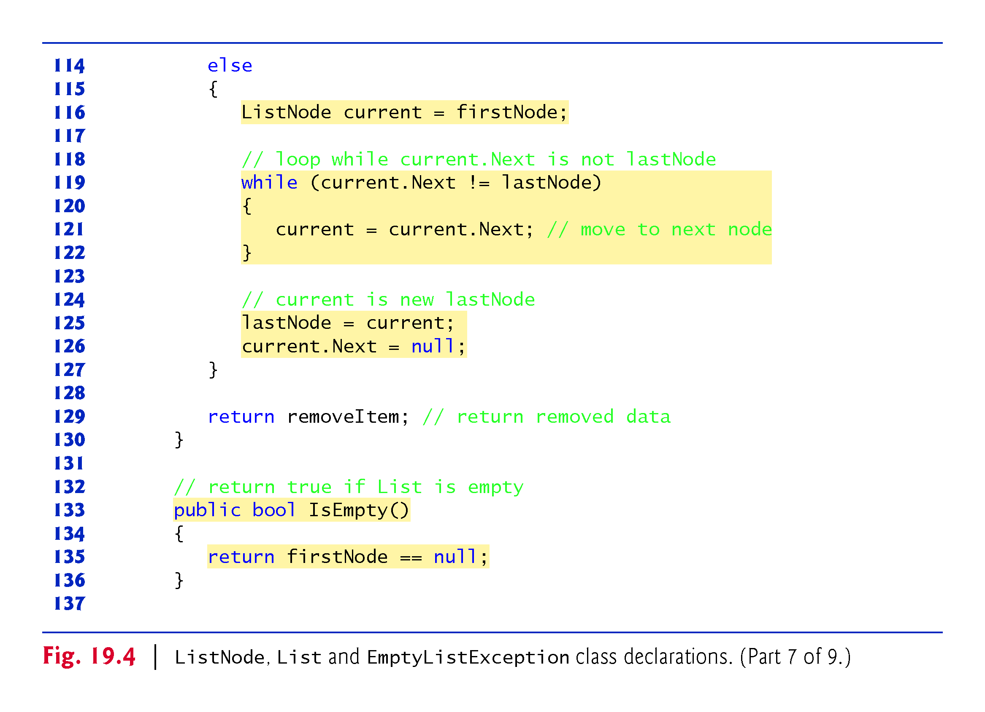
???

Slide 34
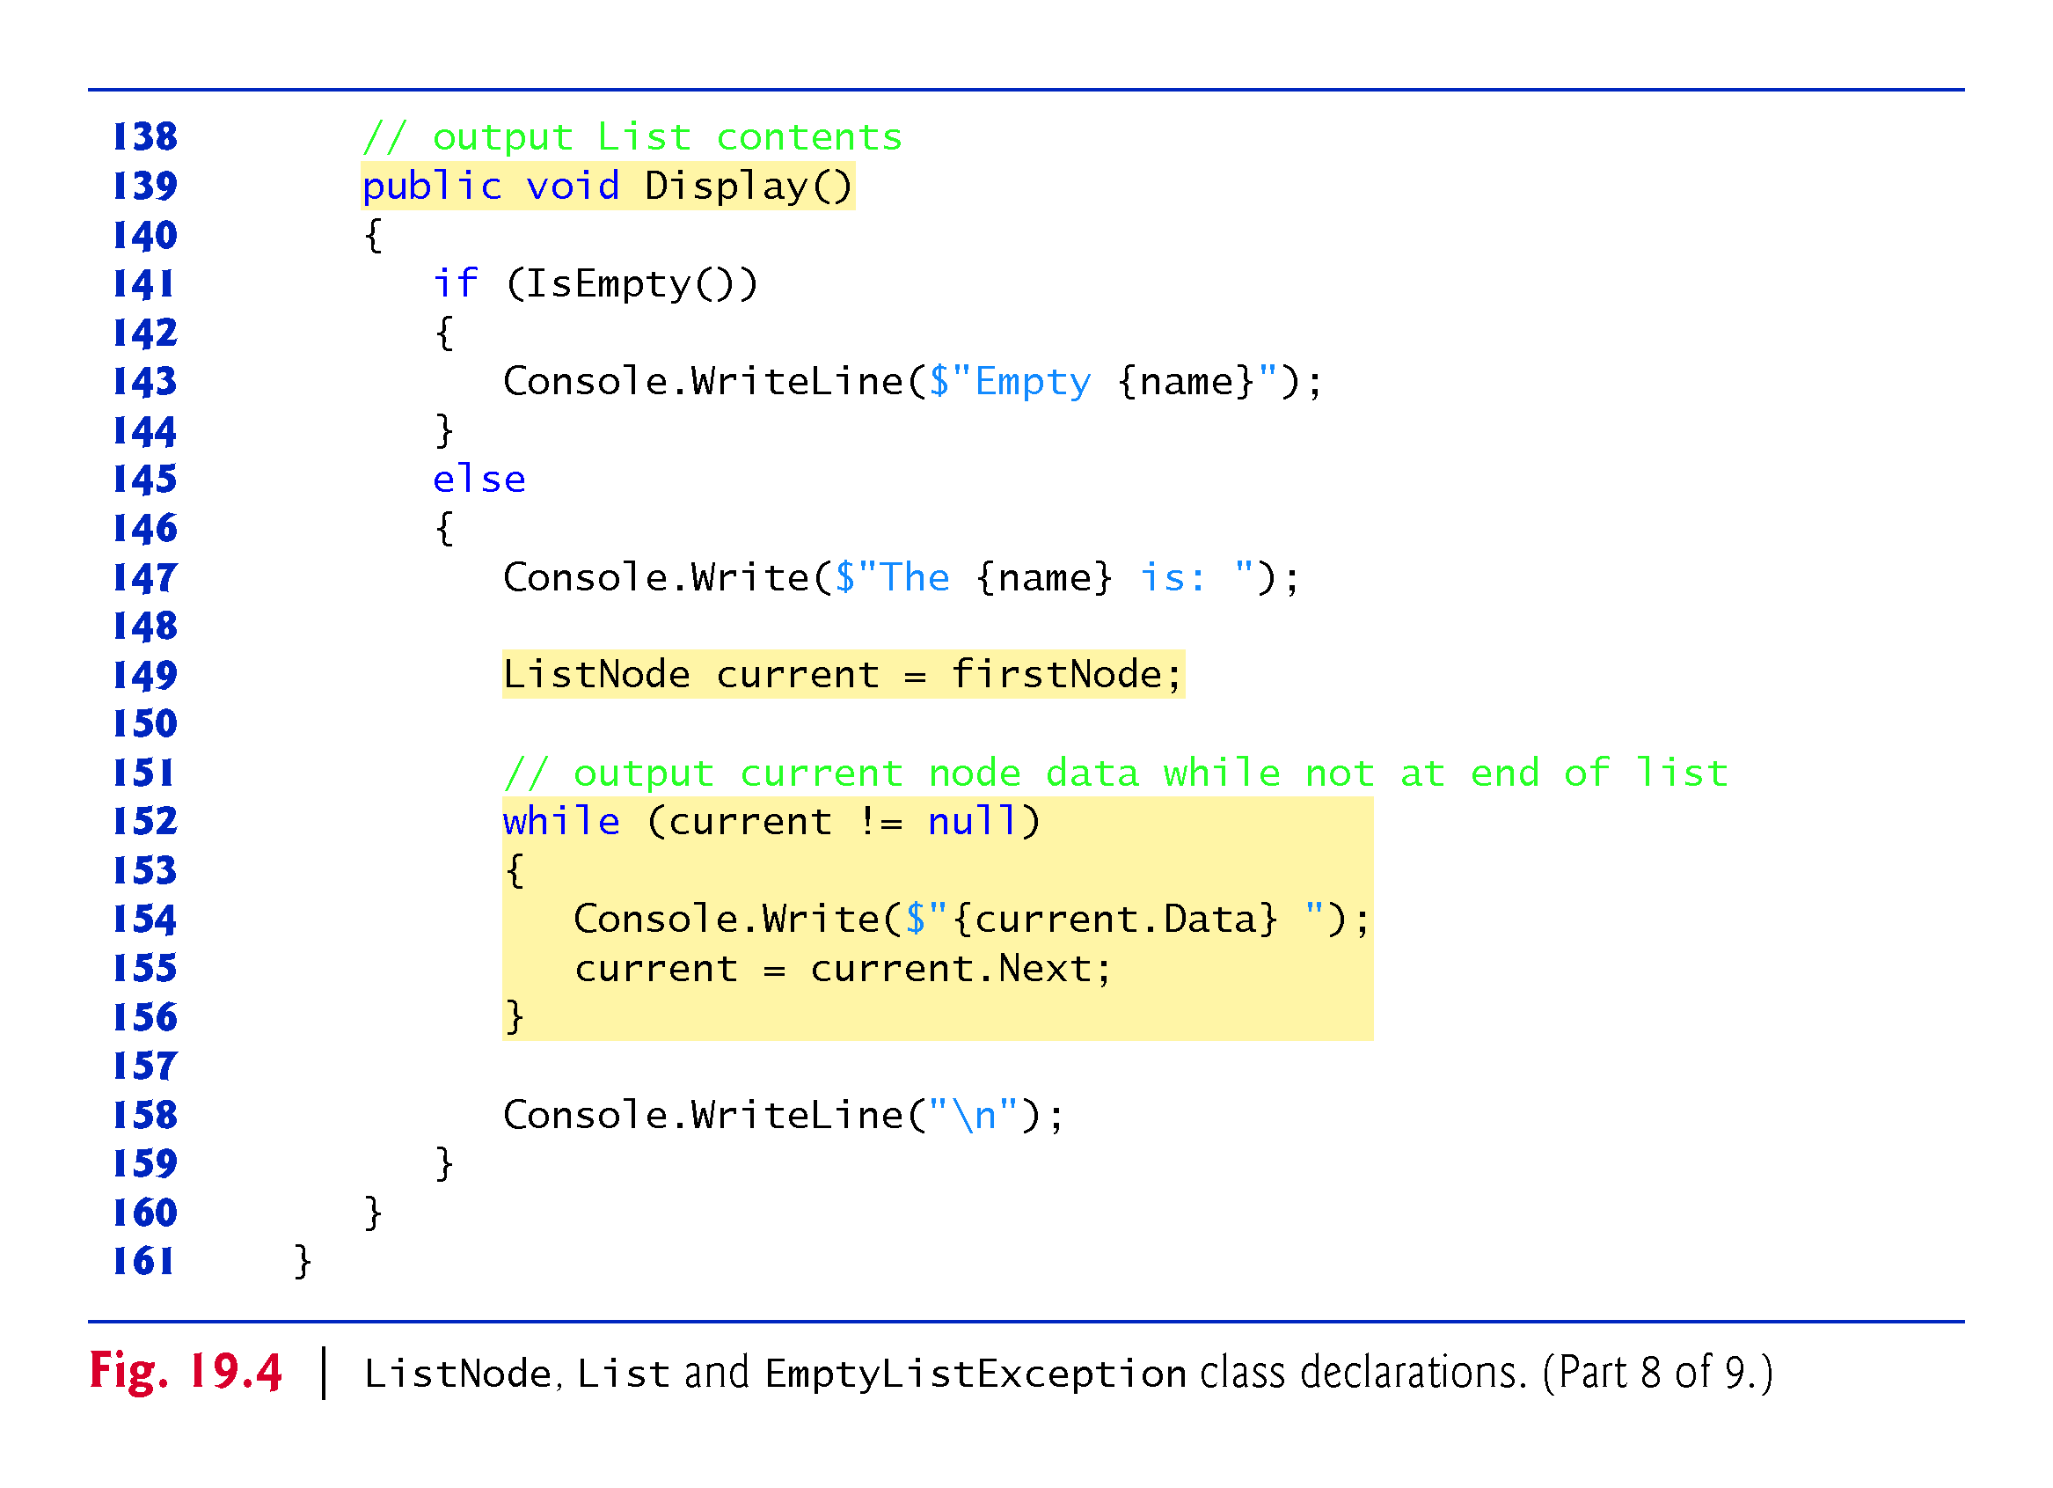

Slide 35
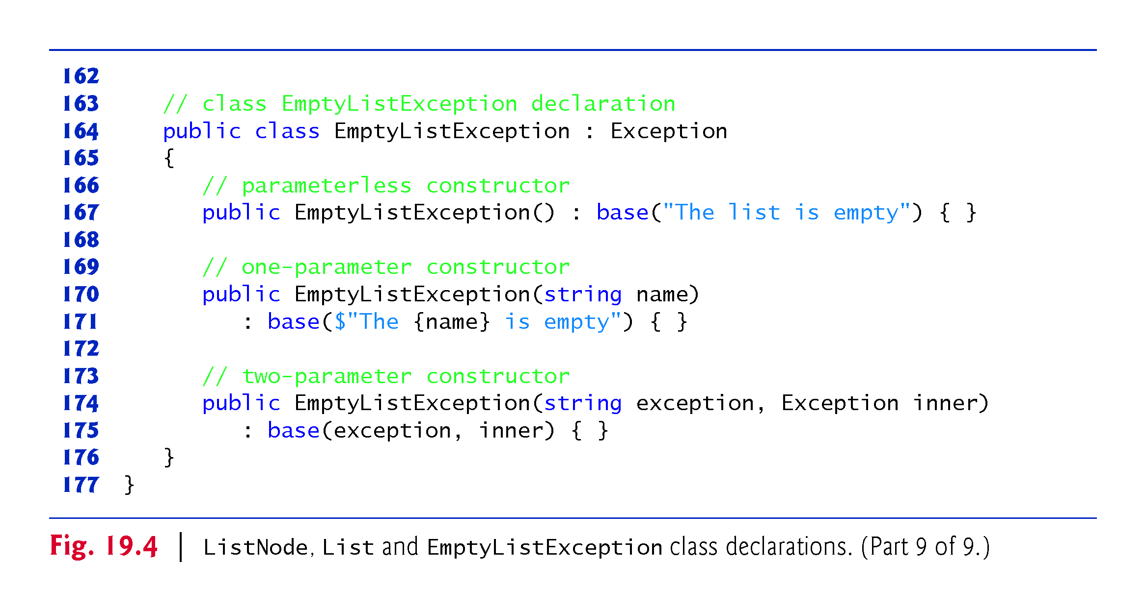

Slide 36
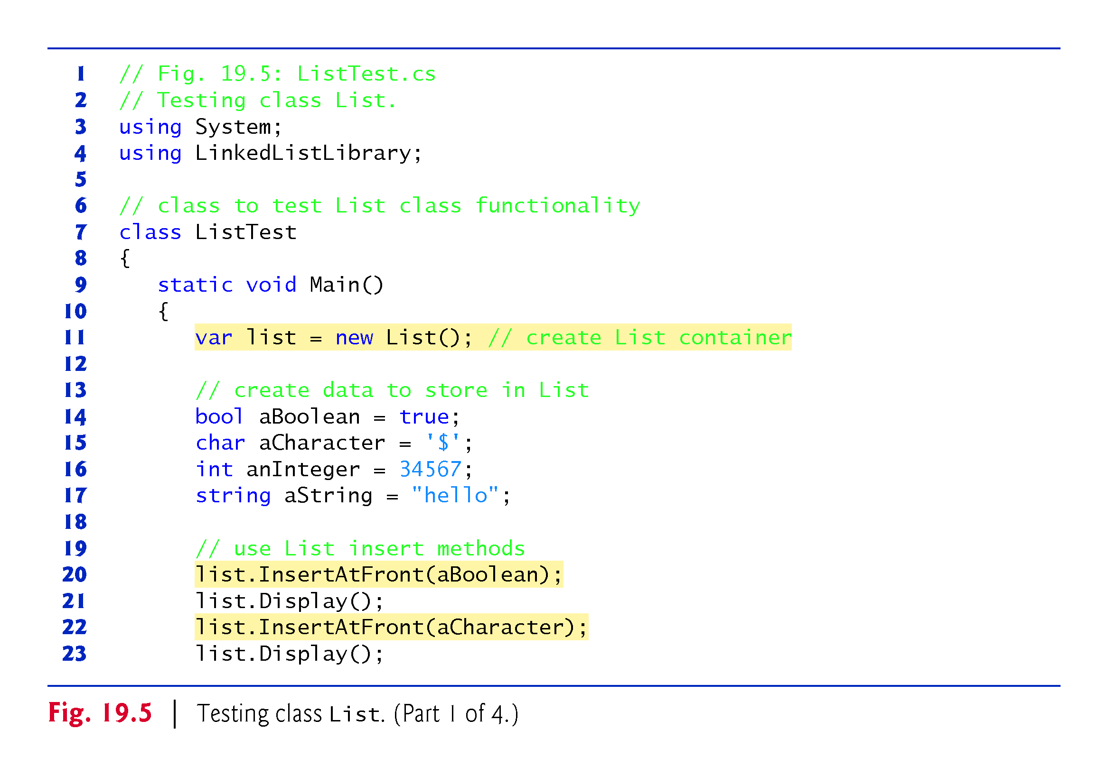
Reason to insert
Int, Boolean???

Slide 37
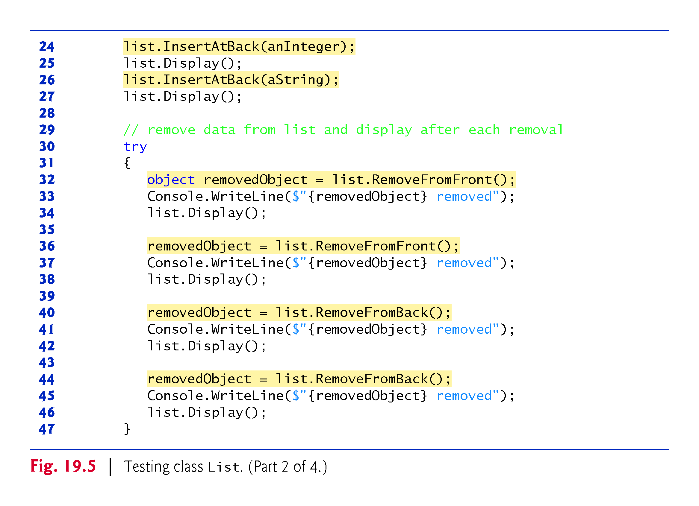

Slide 38
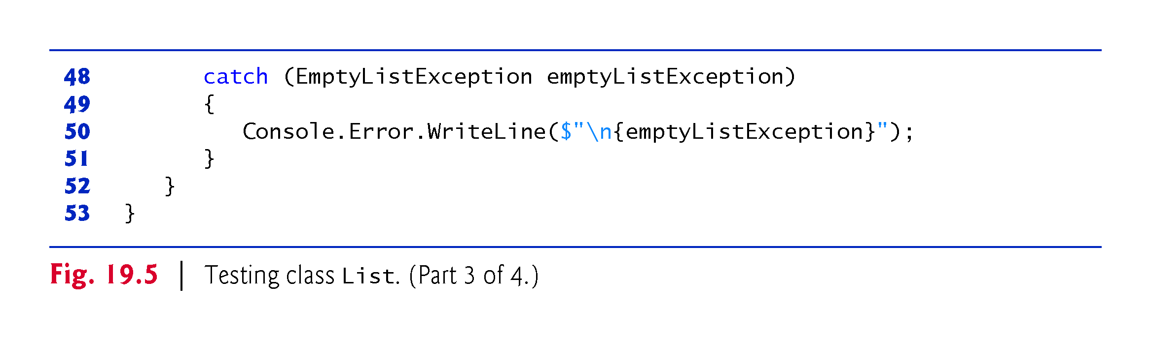

Slide 39
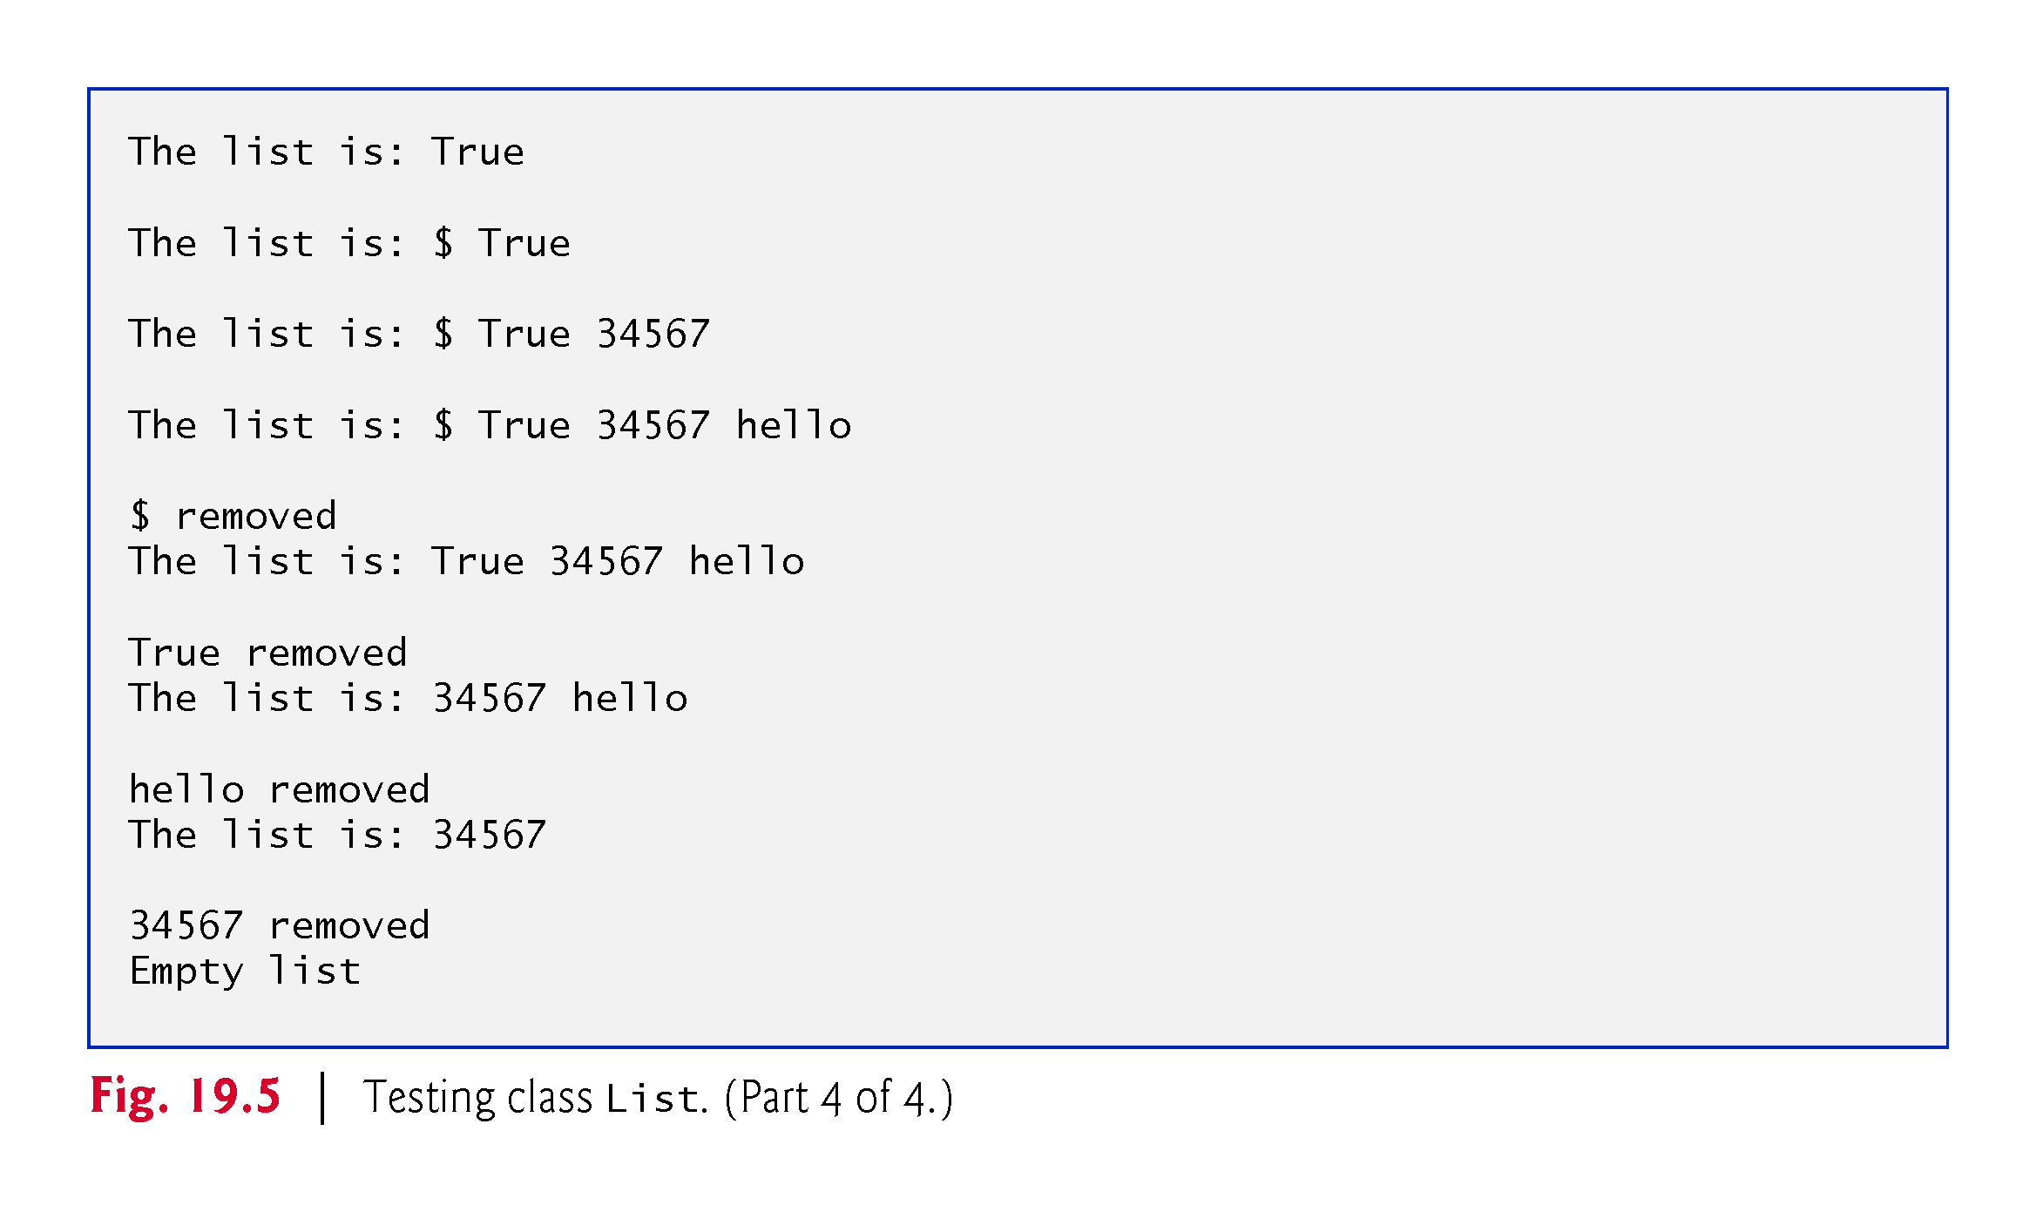

Slide 40
19.4 Linked Lists (cont.)
Method InsertAtFront
Method InsertAtFront places a new node at the front of the list.
The method consists of three steps:
Call IsEmpty to determine whether the list is empty.
If the list is empty, set both firstNode and lastNode to refer to a new ListNode initialized with insertItem. The ListNode constructor at line 18 calls the ListNode constructor at lines 22–26, which sets property Data to refer to the object passed as the first argument and sets the Next property’s reference to null.

Slide 41
19.4 Linked Lists (cont.)
If the list is not empty, the new node is “linked” into the list by setting firstNode to refer to a new ListNode object initialized with insertItem and firstNode.
When the ListNode constructor executes, it sets property Data to refer to the object passed as the first argument and performs the insertion by setting the Next reference to the ListNode passed as the second argument.

Slide 42
19.4 Linked Lists (cont.)
In Fig. 19.6, part (a) shows a list and a new node during the InsertAtFront operation before the new node is linked into the list.
The dashed lines and arrows in part (b) illustrate Step 3 of the InsertAtFront operation, which enables the node containing 12 to become the new list front.

Slide 43
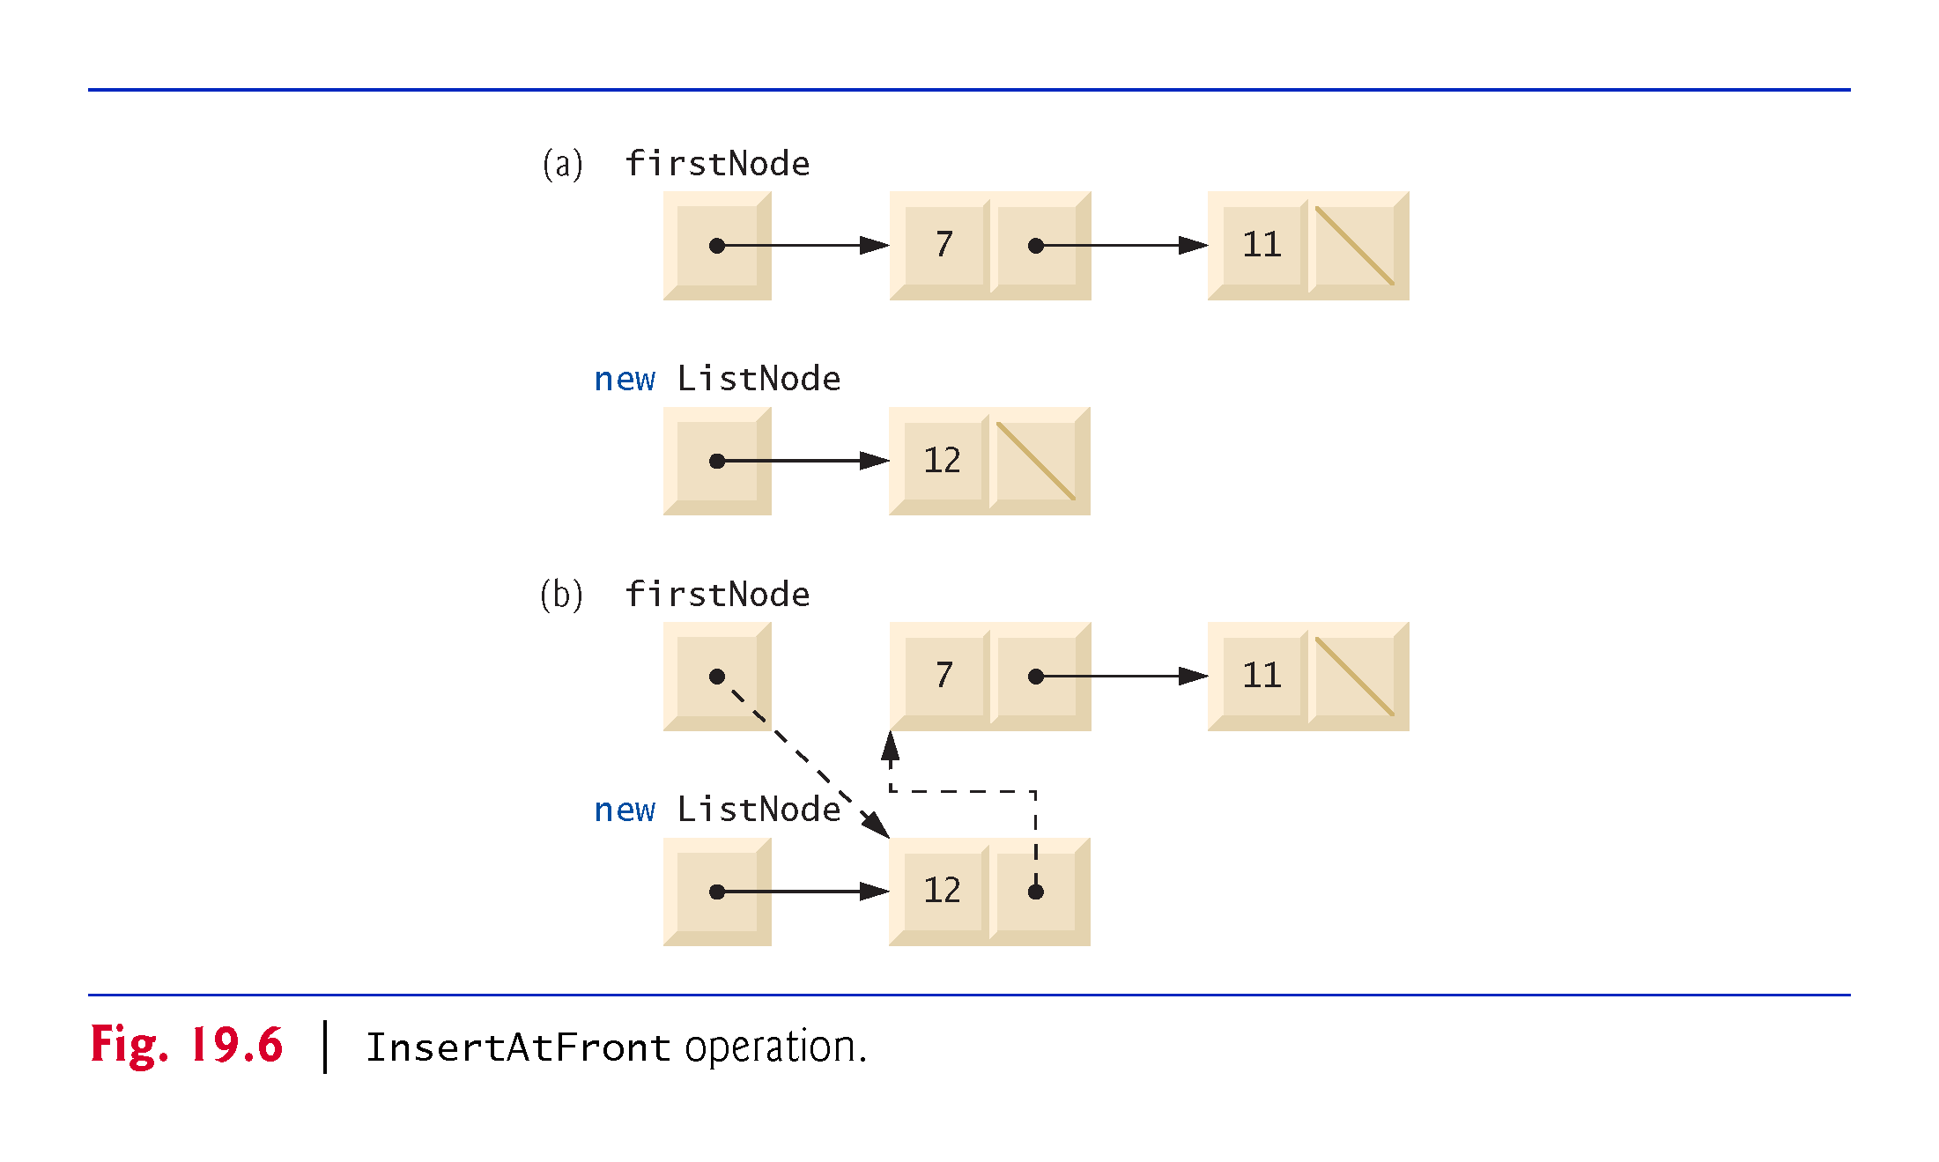

Slide 44
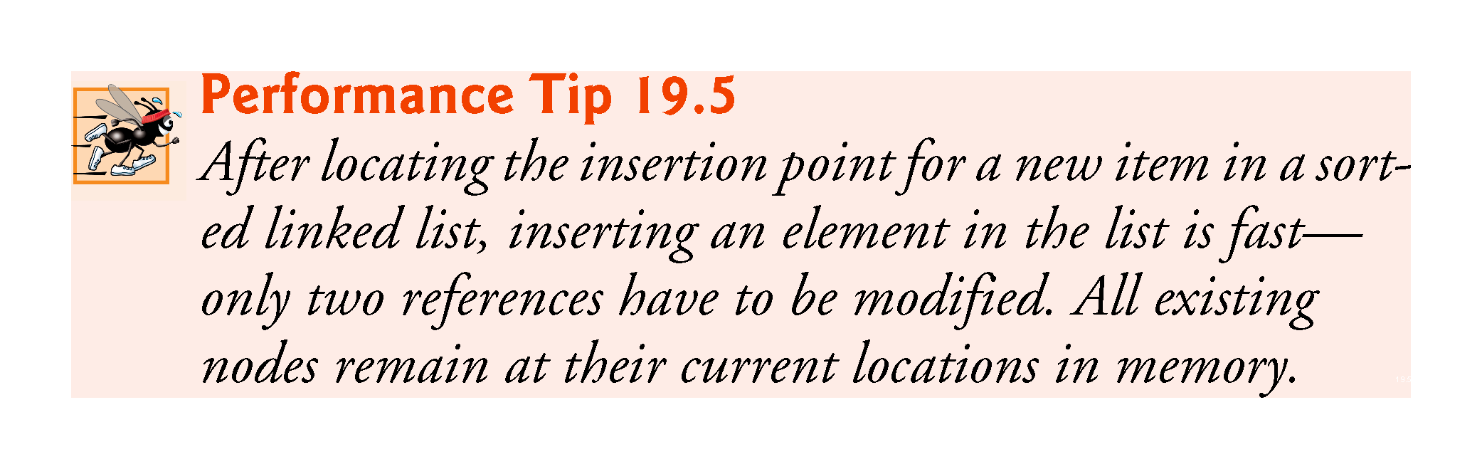

Slide 45
19.4 Linked Lists (cont.)
Method InsertAtBack
Method InsertAtBack places a new node at the back of the list.
The method consists of three steps:
Call IsEmpty to determine whether the list is empty (line 66).
If the list is empty, set both firstNode and lastNode to refer to a new ListNode initialized with insertItem (line 68). The ListNode constructor at line 18 calls the ListNode constructor at lines 22–26, which sets property Data to refer to the object passed as the first argument and sets the Next reference to null.

Slide 46
19.4 Linked Lists (cont.)
If the list is not empty, link the new node into the list by setting lastNode and lastNode.Next to refer to a new ListNode object initialized with insertItem (line 72). When the ListNode constructor (line 18) executes, it calls the constructor at lines 22–26, which sets property Data to refer to the object passed as an arument and sets the Next reference to null.
In Fig. 19.7, part (a) shows a list and a new node during the InsertAtBack operation before the new node has been linked into the list.
The dashed lines and arrows in part (b) illustrate Step 3 of method InsertAtBack, which enables a new node to be added to the end of a list that is not empty.

Slide 47
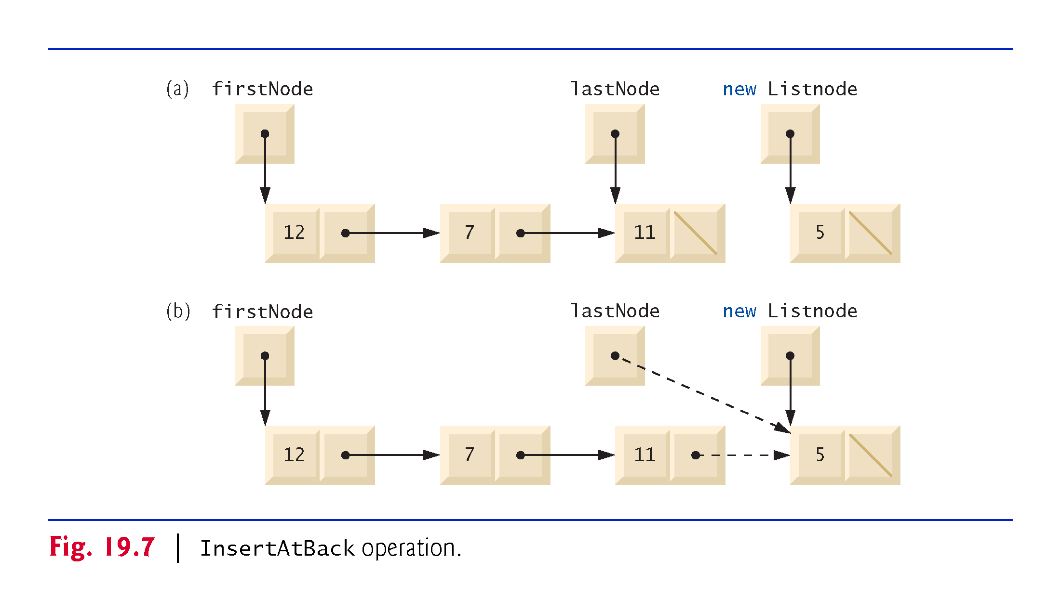

Slide 48
19.4 Linked Lists (cont.)
Method RemoveFromFront
In Fig. 19.8, part (a) illustrates a list before a removal operation.
The dashed lines and arrows in part (b) show the reference manipulations.

Slide 49
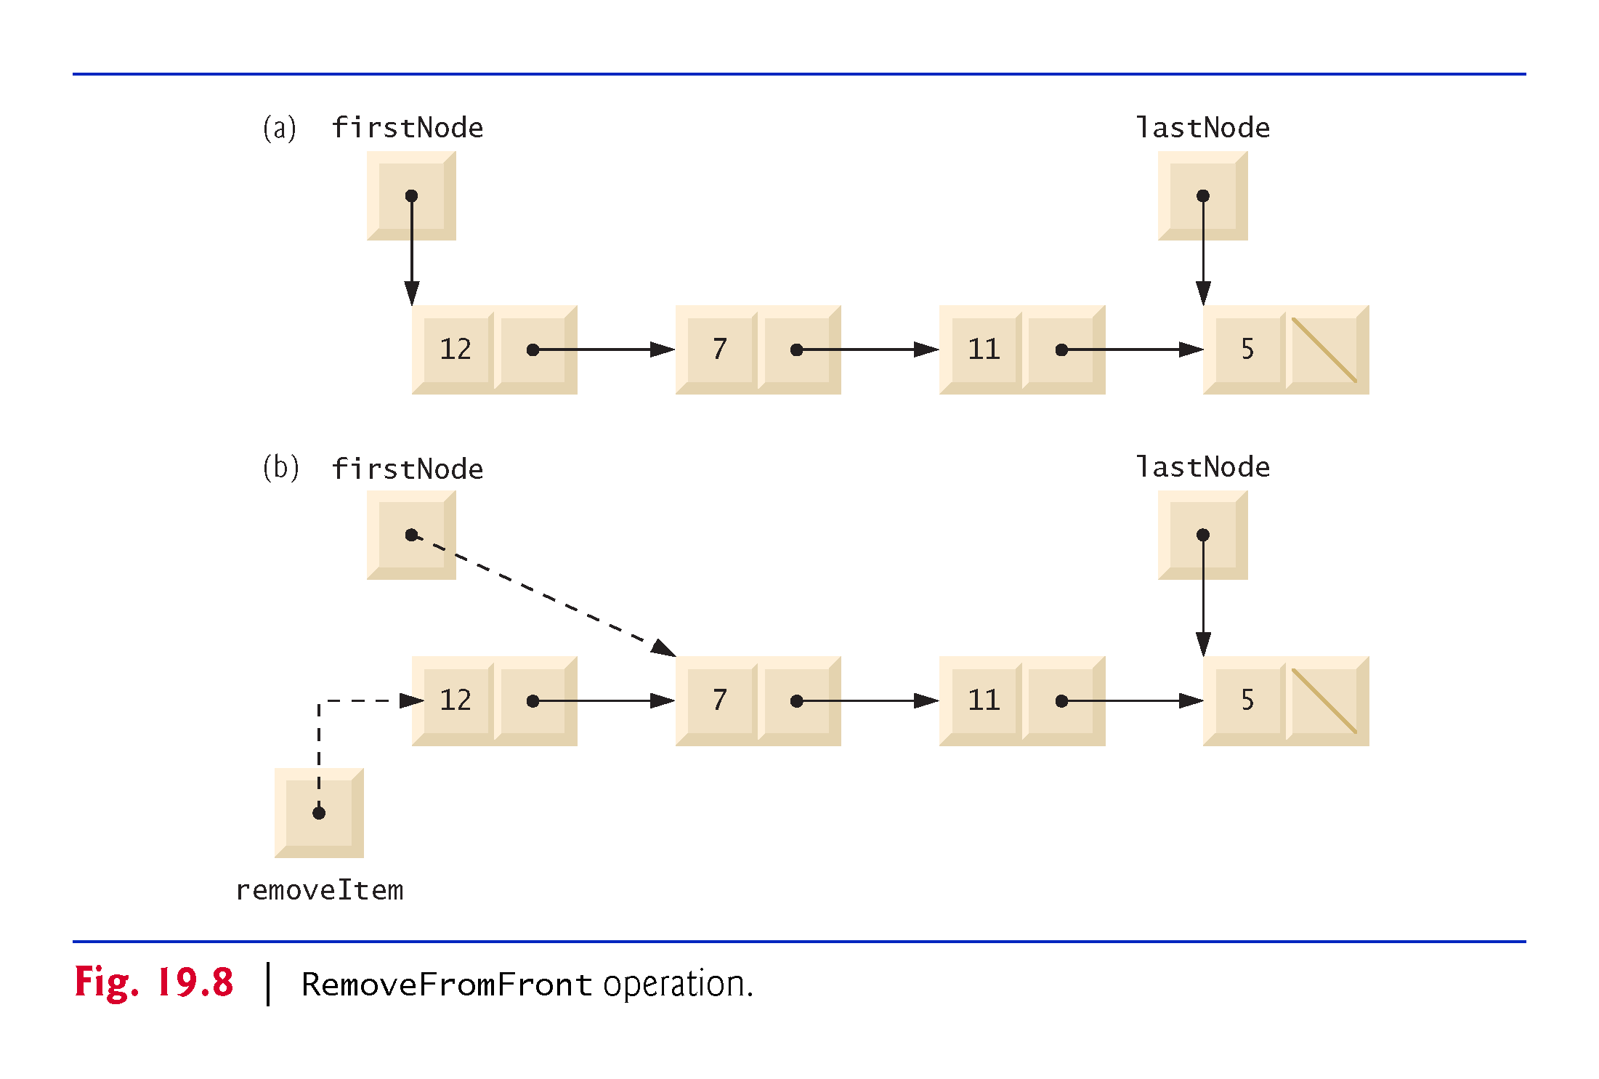

Slide 50
19.4 Linked Lists (cont.)
Method RemoveFromBack
In Fig. 19.9, part (a) illustrates a list before a removal operation.
The dashed lines and arrows in part (b) show the reference manipulations.

Slide 51
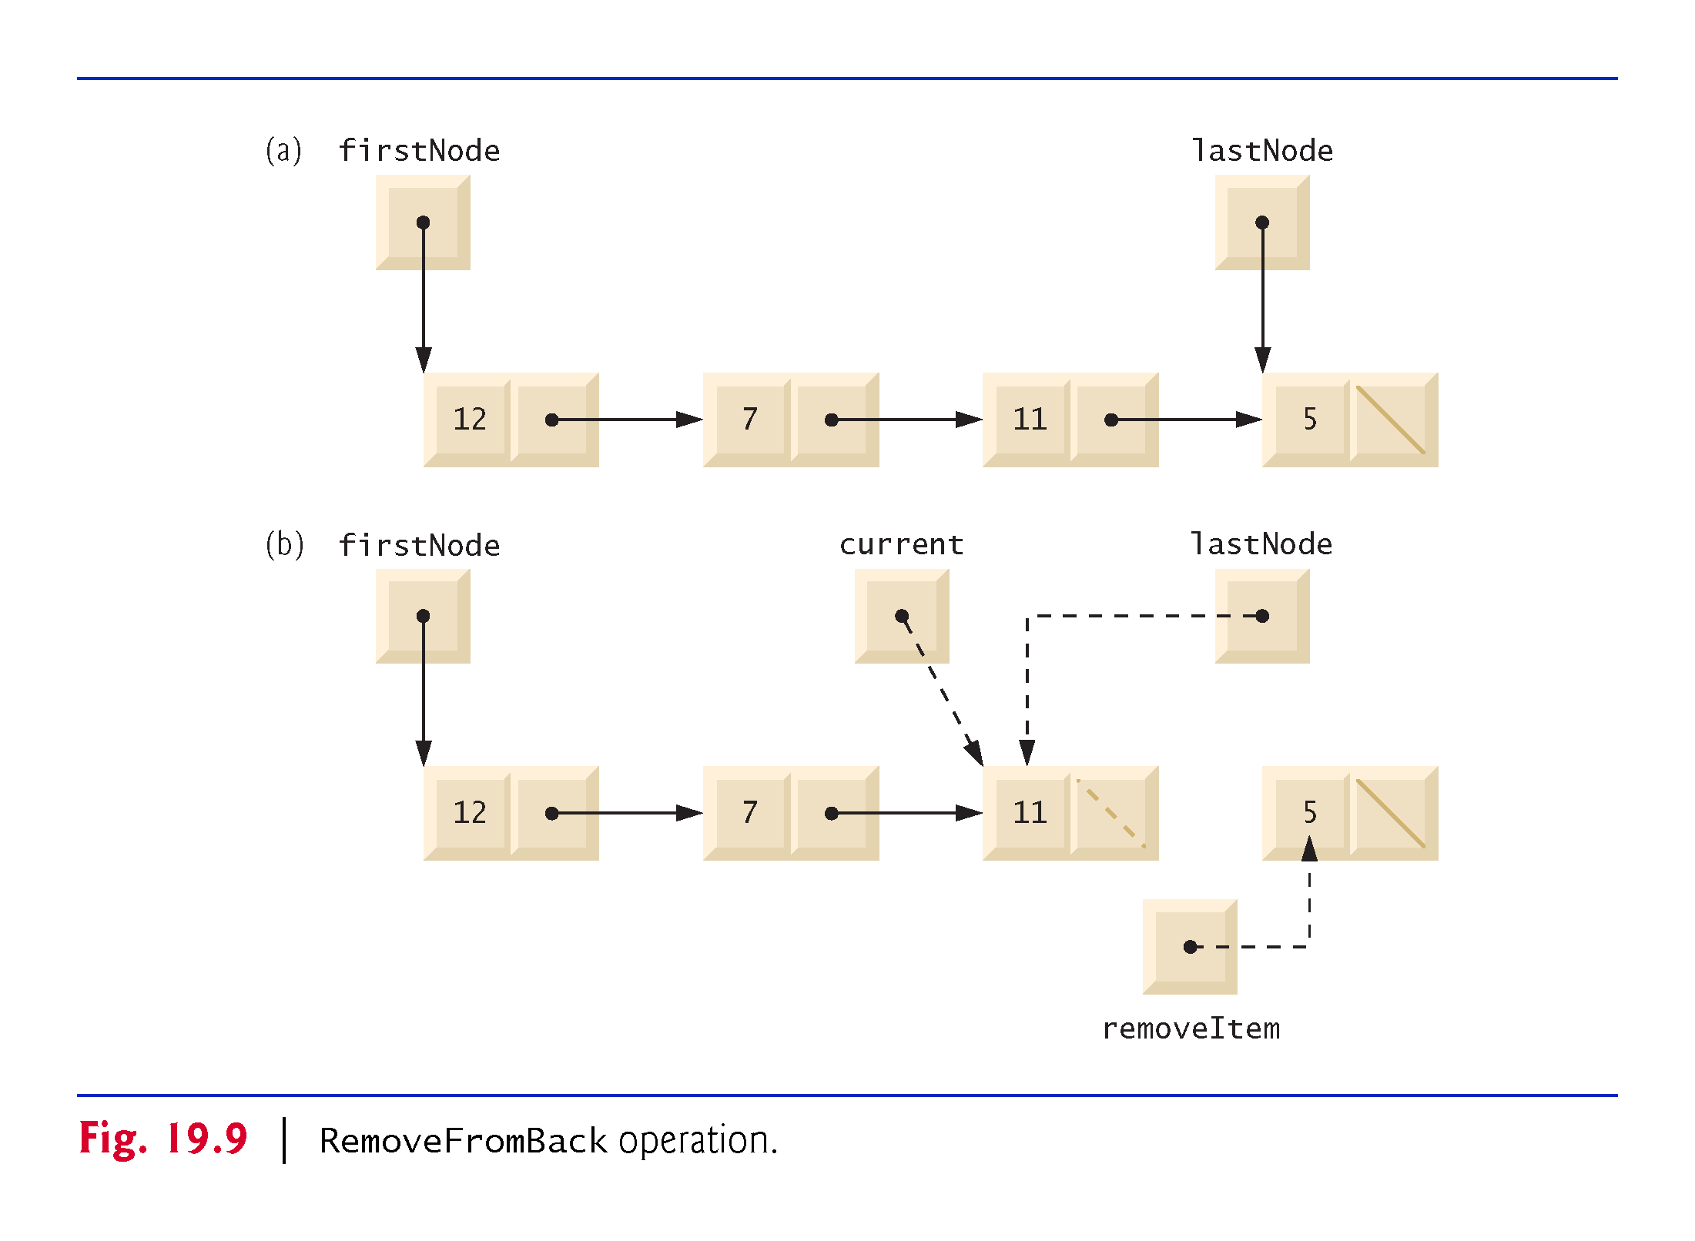

Slide 52
19.4 Linked Lists (cont.)
Linear and Circular Singly Linked and Doubly Linked Lists
A circular, singly linked list (Fig. 19.10) begins with a reference to the first node, and each node contains a reference to the next node.
The “last node” does not contain a null reference; rather, the reference in the last node points back to the first node, thus closing the “circle.”
!!!

Slide 53
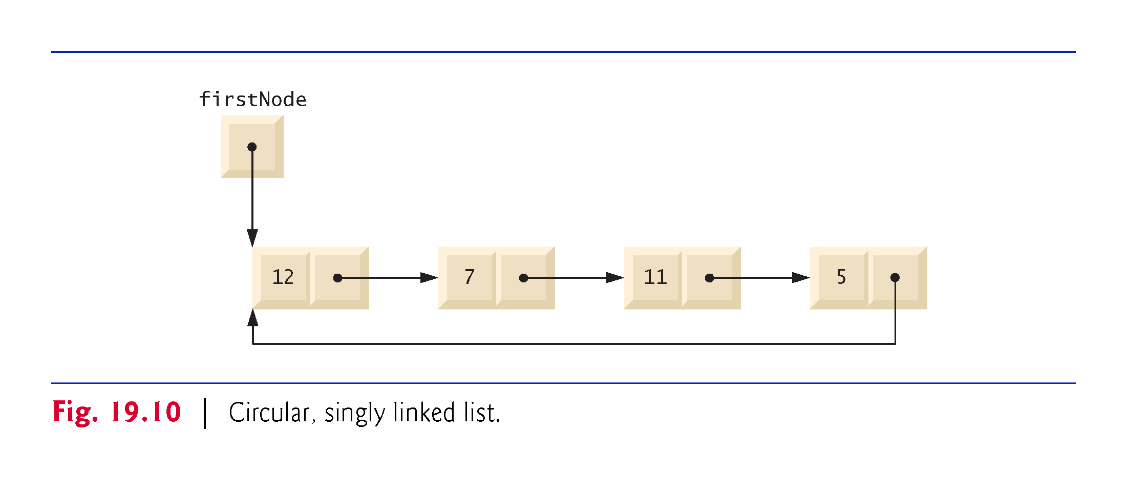
!!!

Slide 54
19.4 Linked Lists (cont.)
A doubly linked list (Fig. 19.11) allows traversals both forward and backward. Such a list is often implemented with two “start references”—one that refers to the first element of the list to allow front-to-back traversal of the list and one that refers to the last element to allow back-to-front traversal.
In a circular, doubly linked list (Fig. 19.12), the forward reference of the last node refers to the first node, and the backward reference of the first node refers to the last node, thus closing the “circle.”
!!!

Slide 55
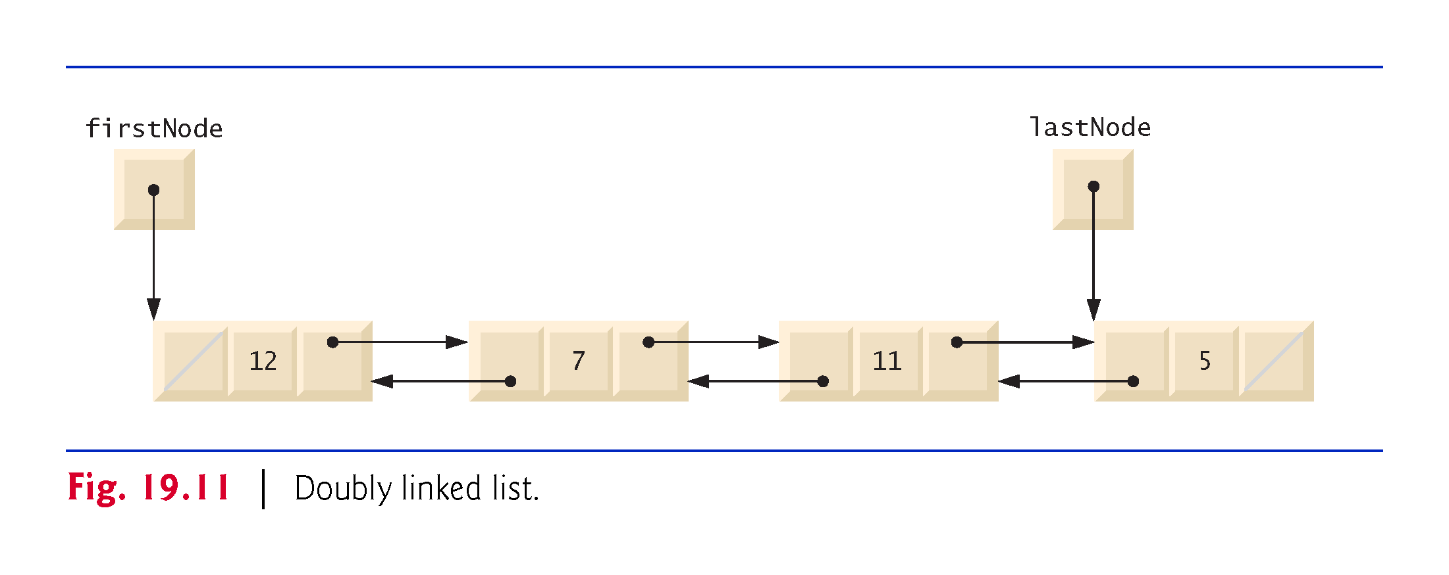

Slide 56
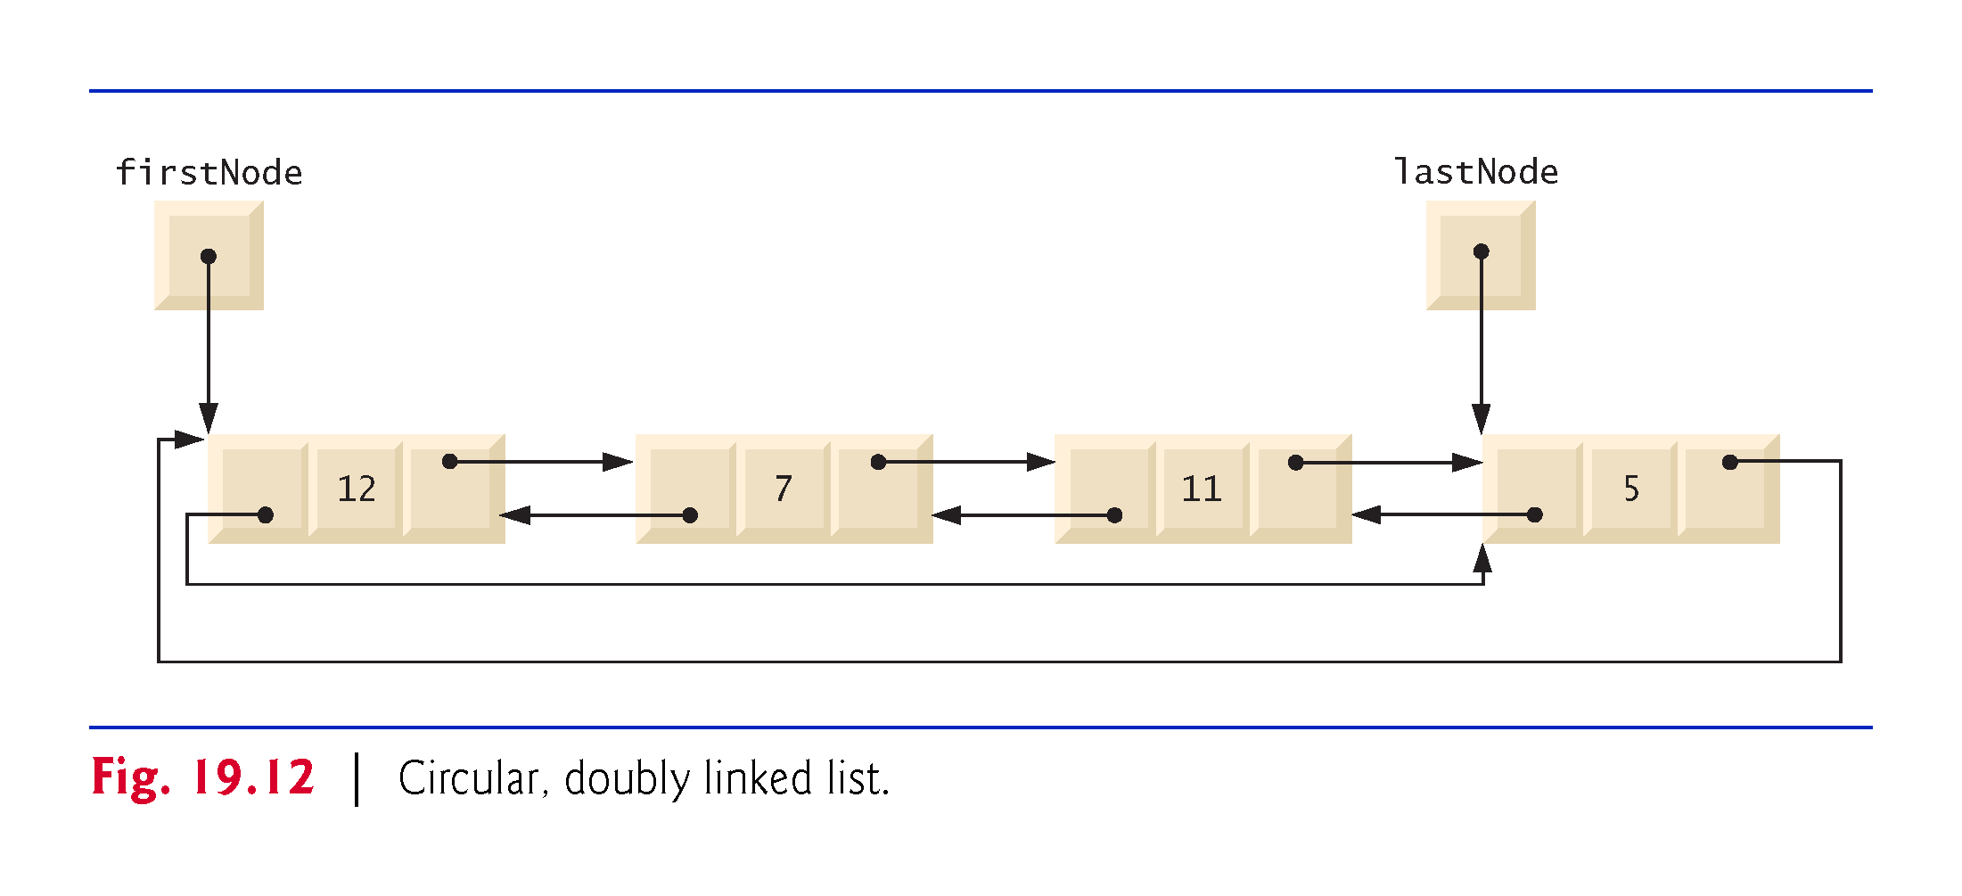

Slide 57
19.5 Stacks
A stack may be viewed as a constrained version of a linked list—it receives new nodes and releases nodes only at the top.
For this reason, a stack is referred to as a last-in, first-out (LIFO) data structure.
The primary operations to manipulate a stack are push and pop.
Operation push adds a new node to the top of the stack.
Operation pop removes a node from the top of the stack and returns the data item from the popped node.
!!!

Slide 58
19.5 Stacks (cont.)
Stack Class That Inherits from List
The code in Fig. 19.13 creates a stack class by inheriting from class List of Fig. 19.4.

Slide 59
Create stack from existing class list by Is-a relation

Slide 60
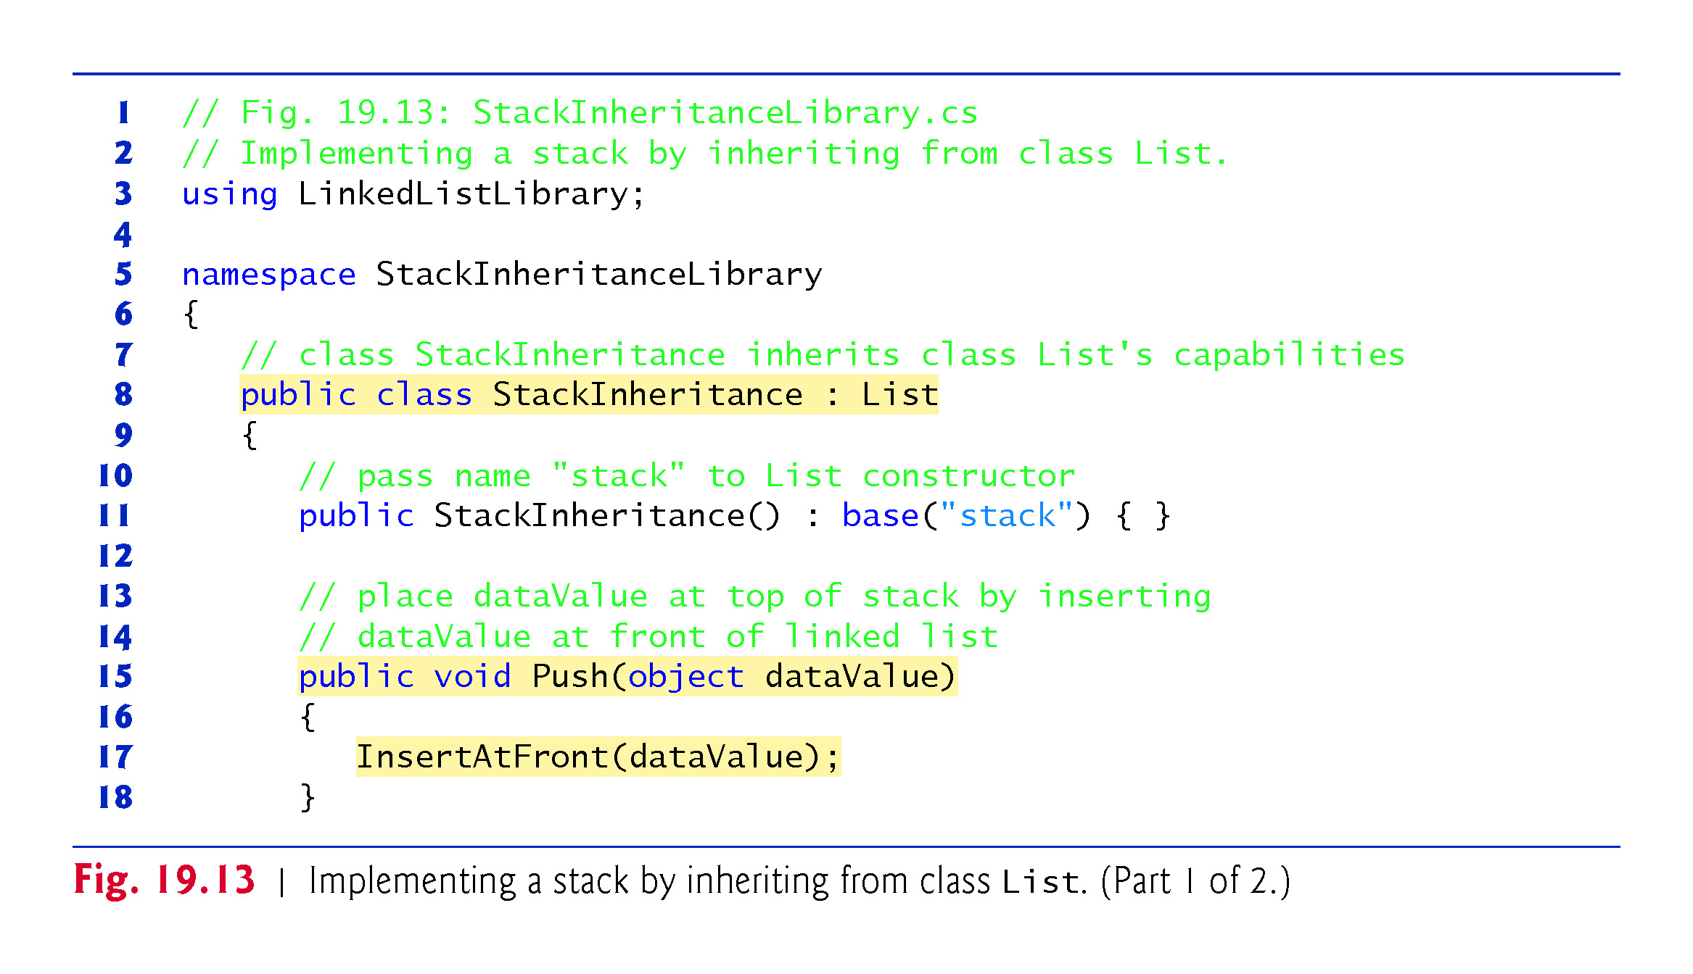
!!!
Is relation
!!!

Slide 61
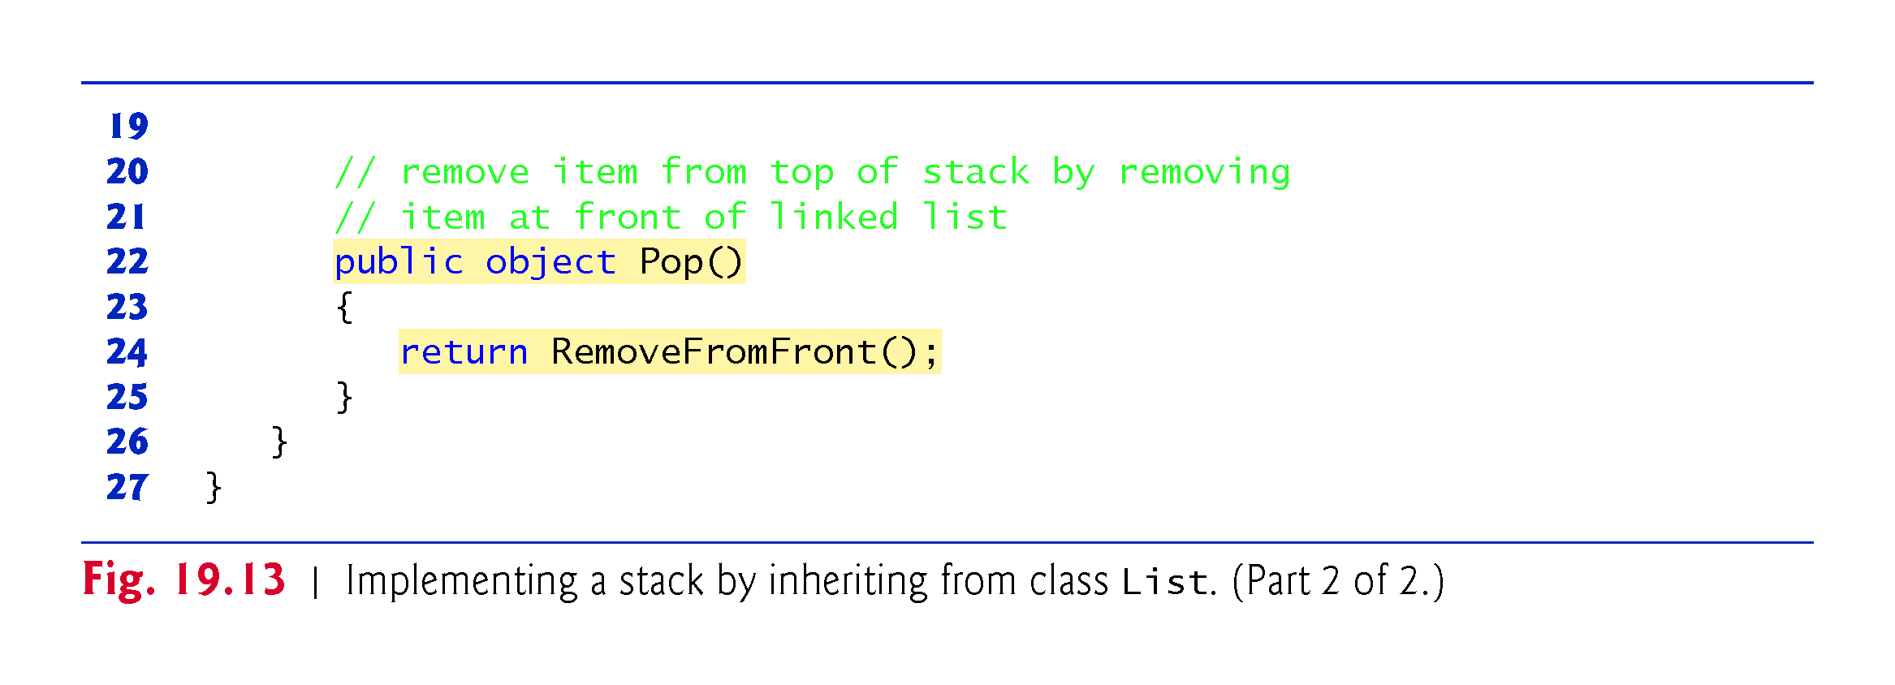
!!!

Slide 62
19.5 Stacks (cont.)
StackInheritanceTest’s Main method (Fig. 19.14) uses class StackInheritance to create a stack of objects called stack.

Slide 63
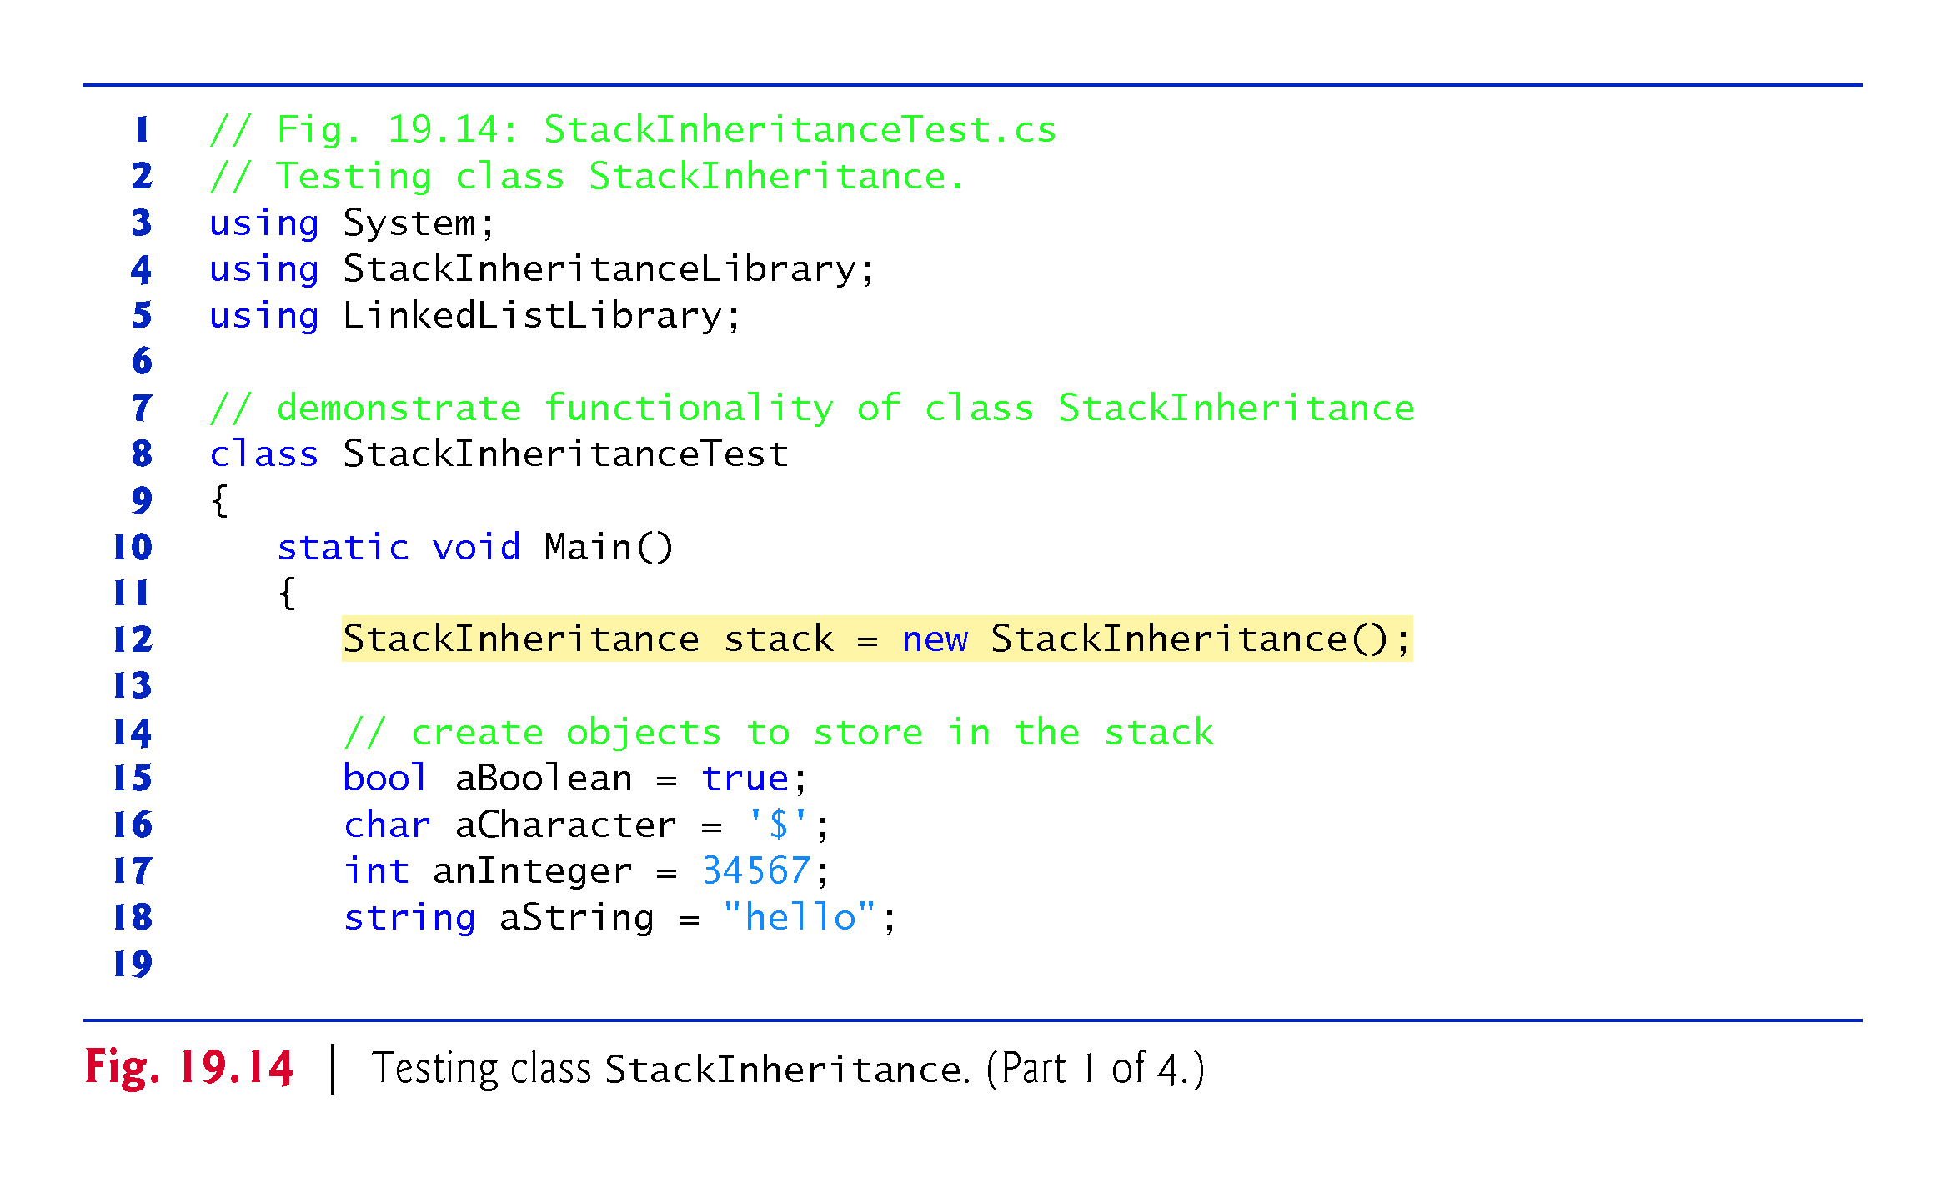
!!!
Why insert a valuetype!!!

Slide 64
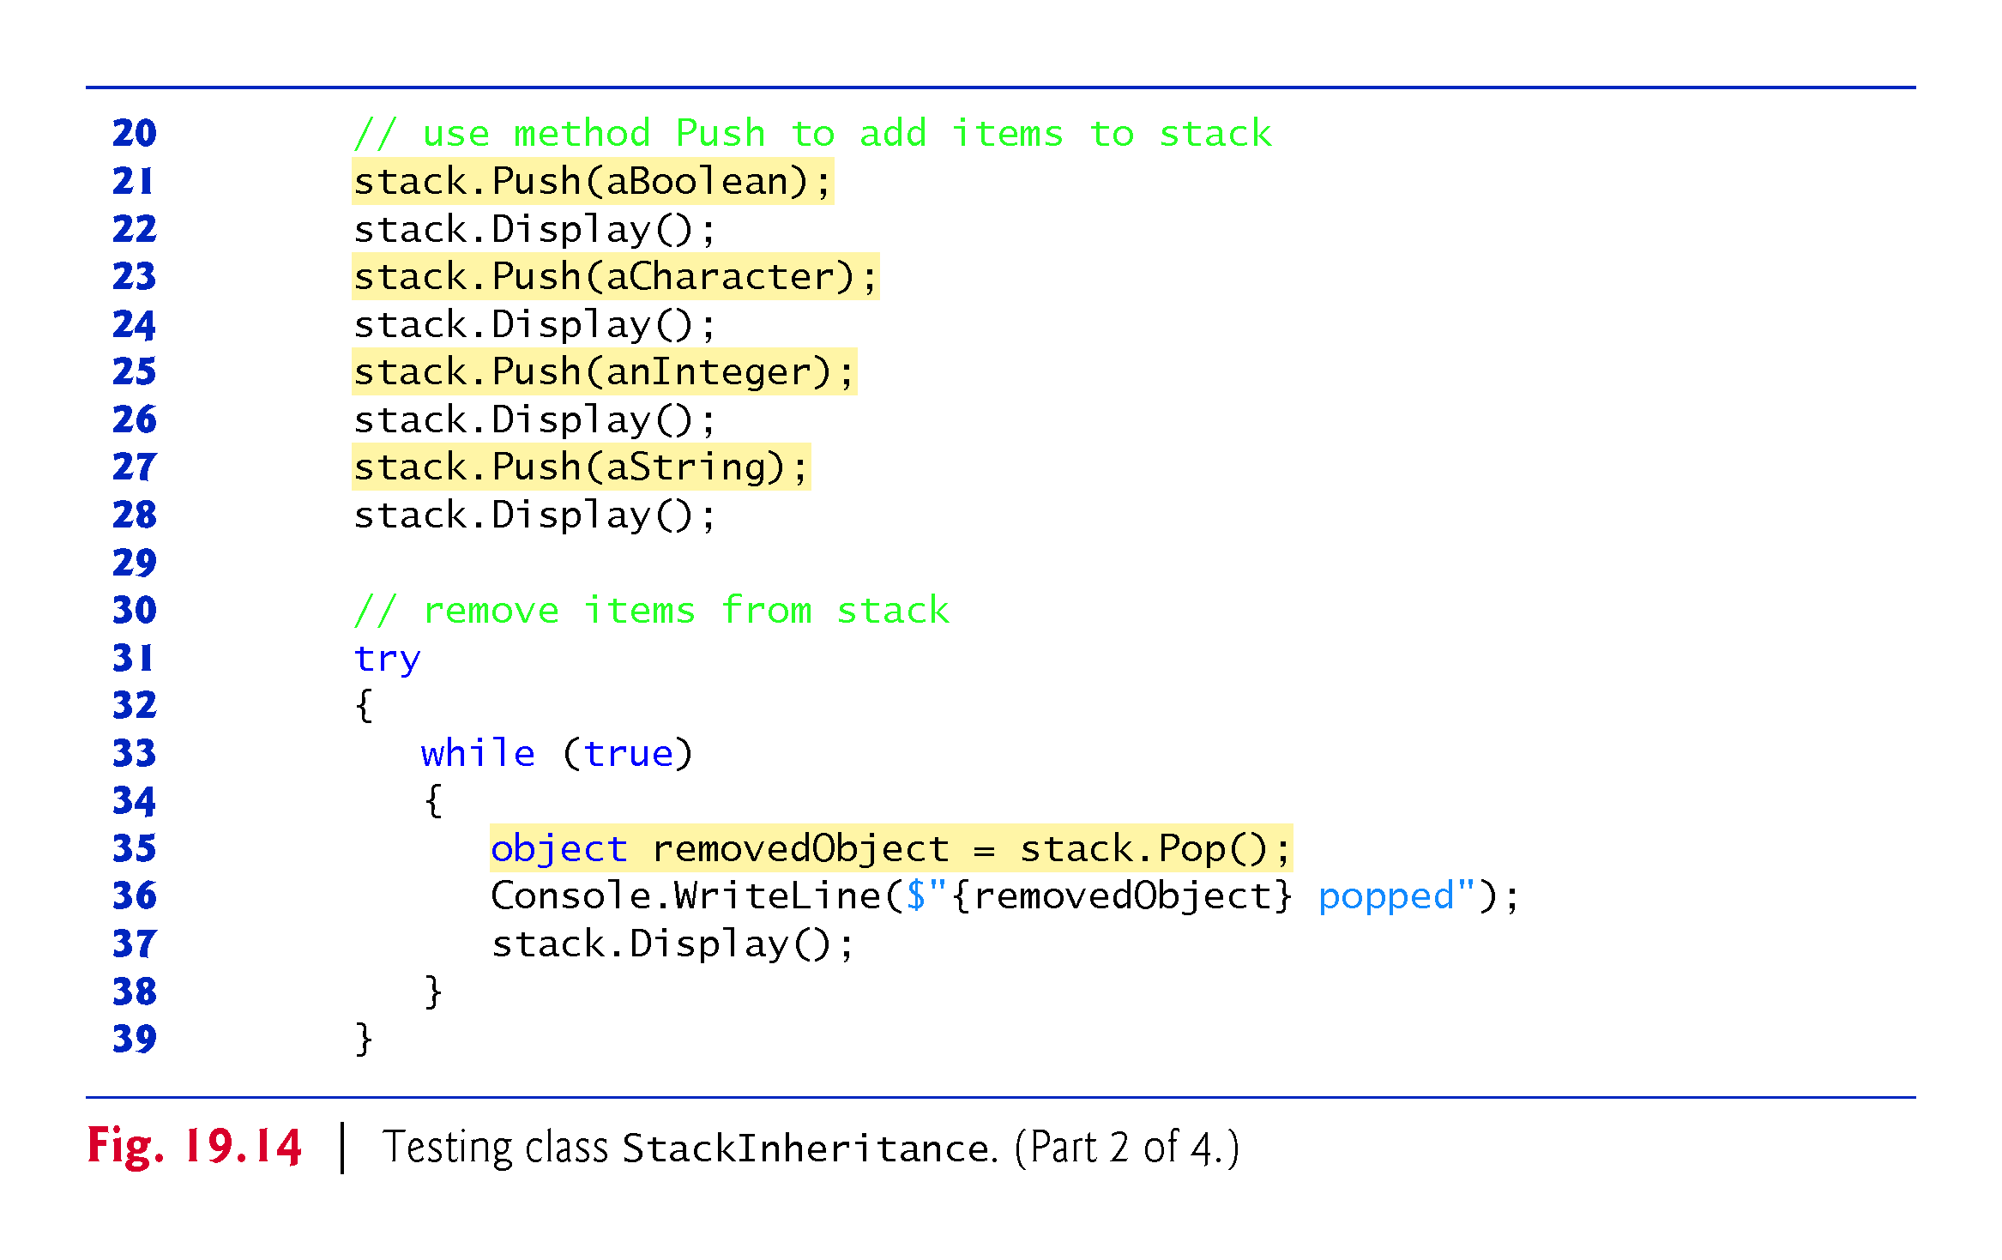

Slide 65
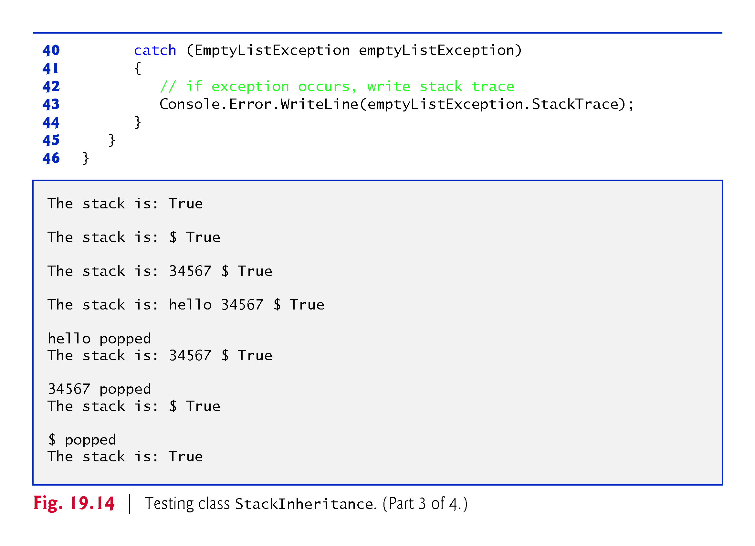

Slide 66
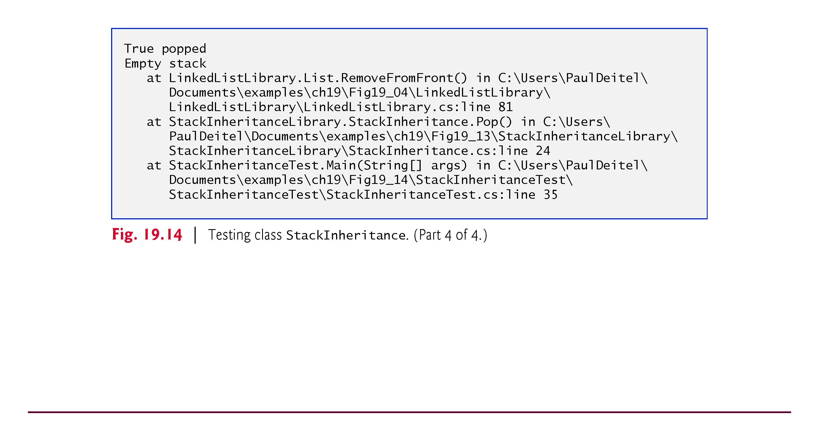

Slide 67
19.5 Stacks (cont.)
Stack Class That Contains a Reference to a List
Another way to implement a stack class is by reusing a list class through composition. The class in Fig. 19.15 uses a private object of class List (line 10) in the declaration of class StackComposition.
Composition enables us to hide the methods of class List that should not be in our stack’s public interface by providing public interface methods only to the required List methods.

Slide 68
19.5 Stacks (cont.)
This class implements each stack method by delegating its work to an appropriate List method.
StackComposition’s methods call List methods Insert-AtFront, RemoveFromFront, IsEmpty and Display.
In this example, we do not show class StackCompositionTest, because the only difference in this example is that we change the name of the stack class from StackInheritance to StackComposition.

Slide 69
Create stack from existing class list by has/composition relation

Slide 70
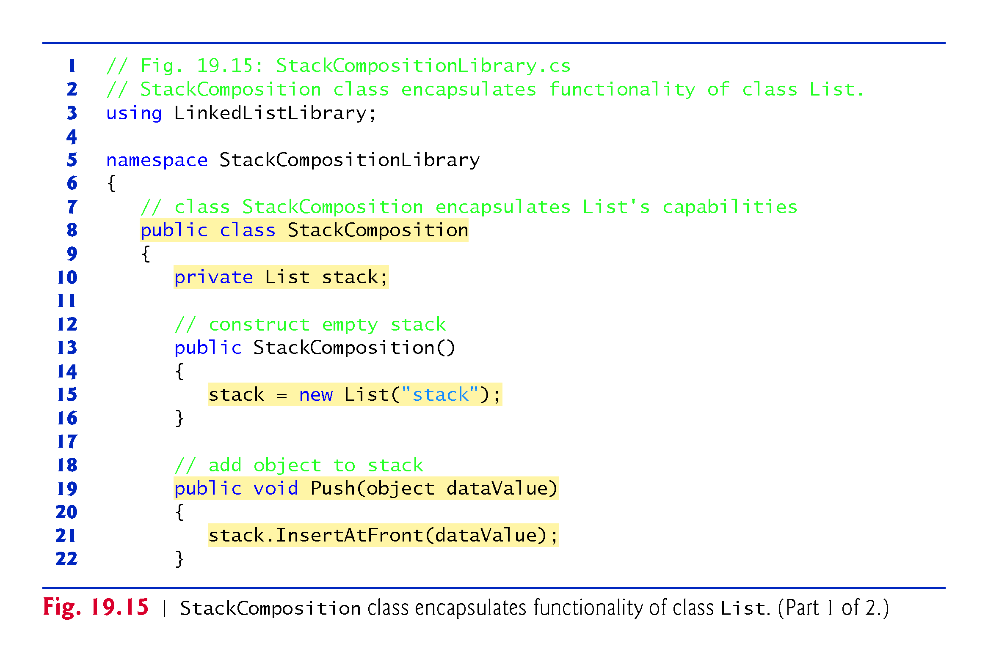
Has relation
!!!

Slide 71
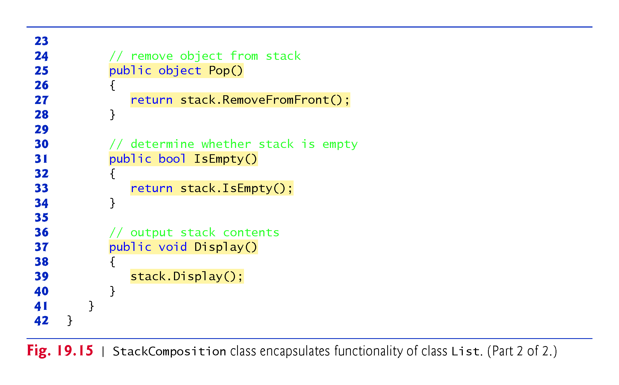
!!!

Slide 72
19.6 Queues
Another commonly used data structure is the queue.
Queue nodes are removed only from the head (or front) of the queue and are inserted only at the tail (or end).
For this reason, a queue is a first-in, first-out (FIFO) data structure.
The insert and remove operations are known as enqueue and dequeue.

Slide 73
19.6 Queues (cont.)
Queues are also used to support print spooling.
For example, a single printer might be shared by all users of a network.
Many users can send print jobs to the printer, even when the printer is already busy.
These print jobs are placed in a queue until the printer becomes available.
A program called a spooler manages the queue to ensure that as each print job completes, the next one is sent to the printer.

Slide 74
19.6 Queues (cont.)
Queue Class That Inherits from List
The code in Fig. 19.16 creates a queue class by inheriting from a list class.

Slide 75
Create Queue from existing class list by Is-a relation

Slide 76
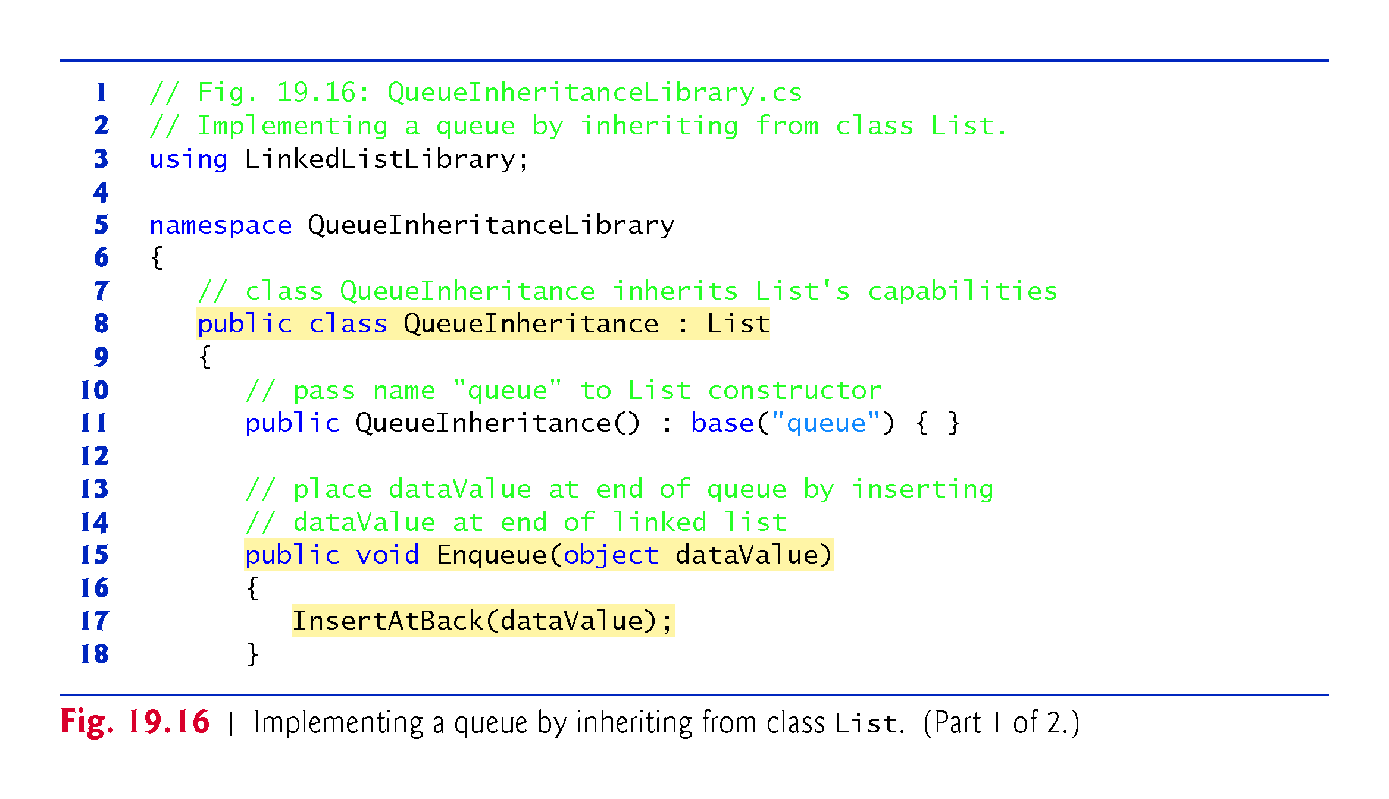
Is relation
!!!

Slide 77
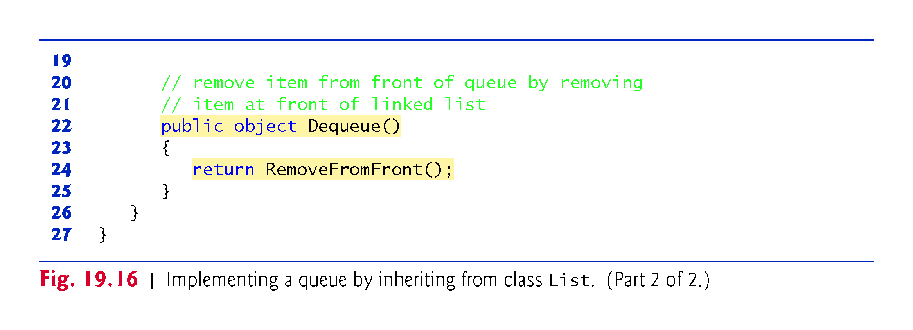
!!!

Slide 78
19.6 Queues (cont.)
Class QueueInheritanceTest’s Main method (Fig. 19.17) creates a QueueInheritance object called queue.

Slide 79
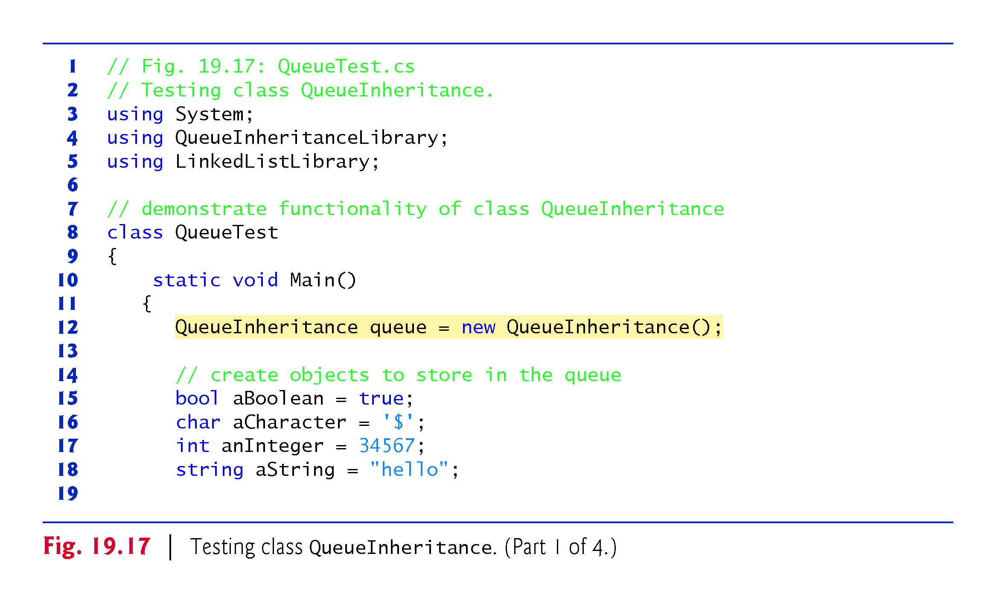

Slide 80
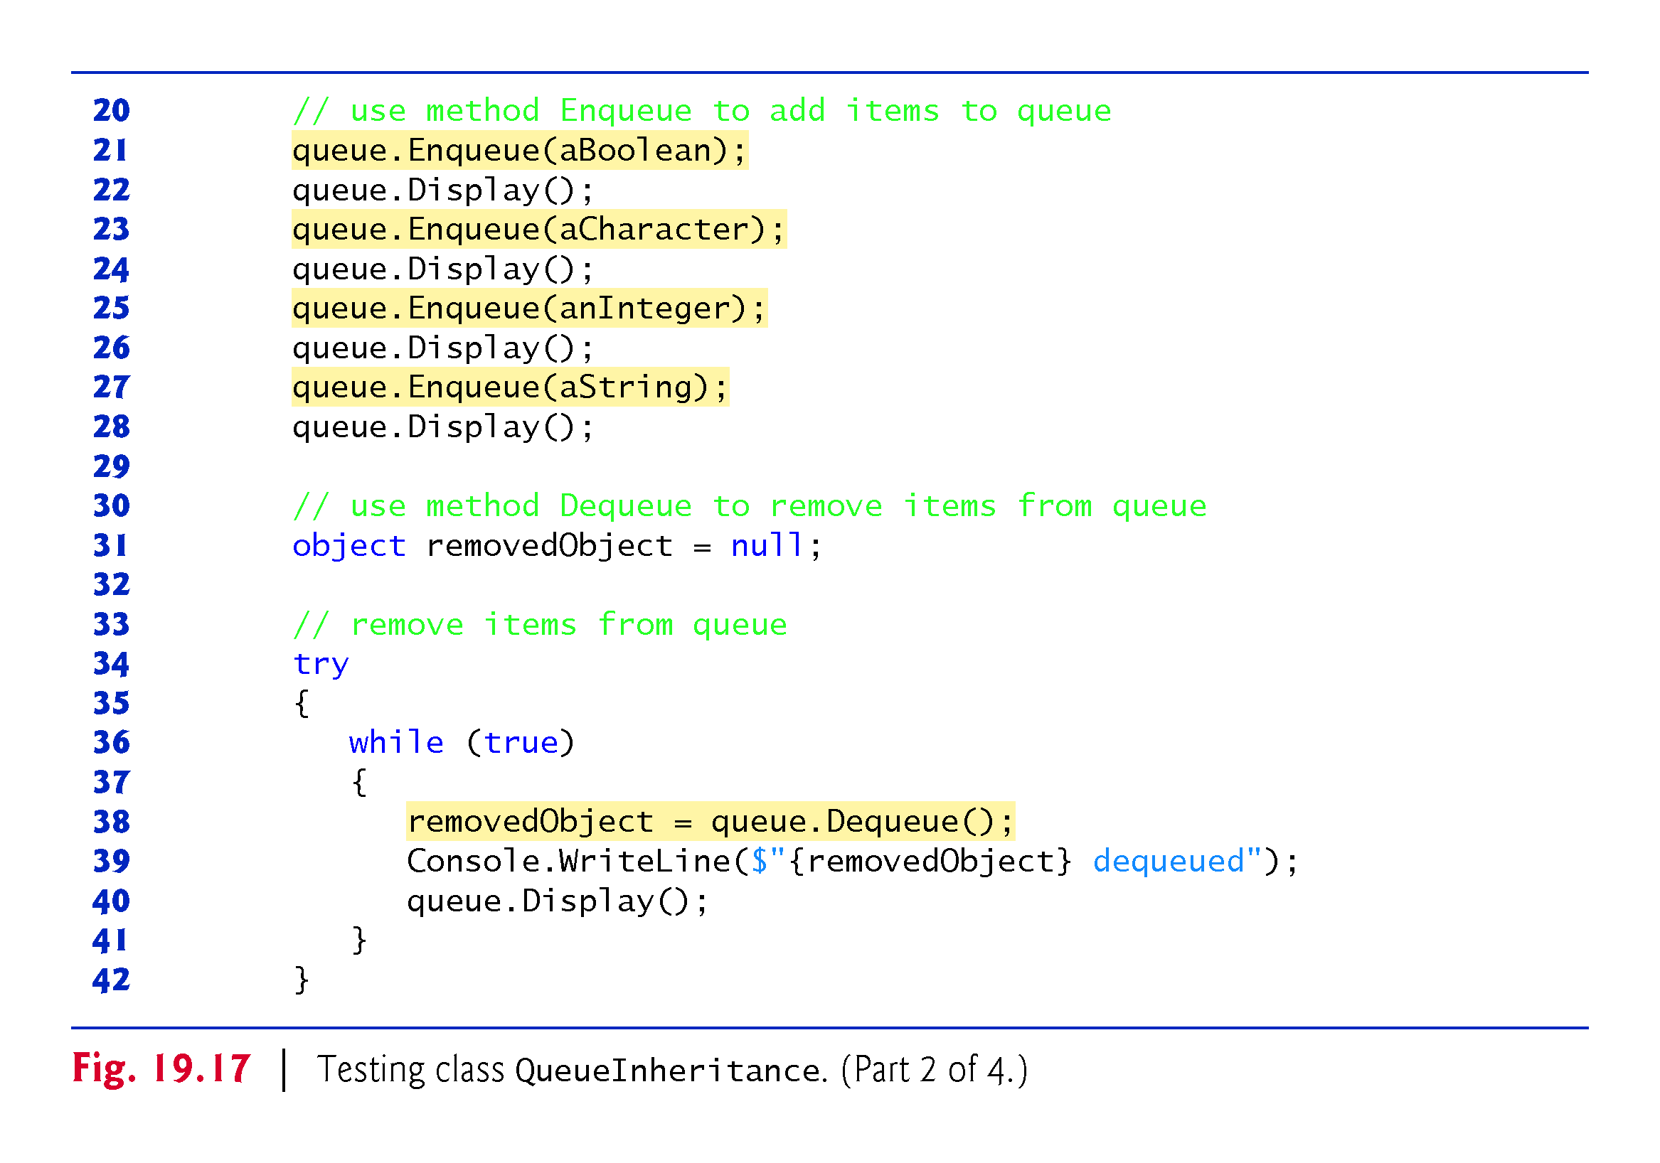

Slide 81
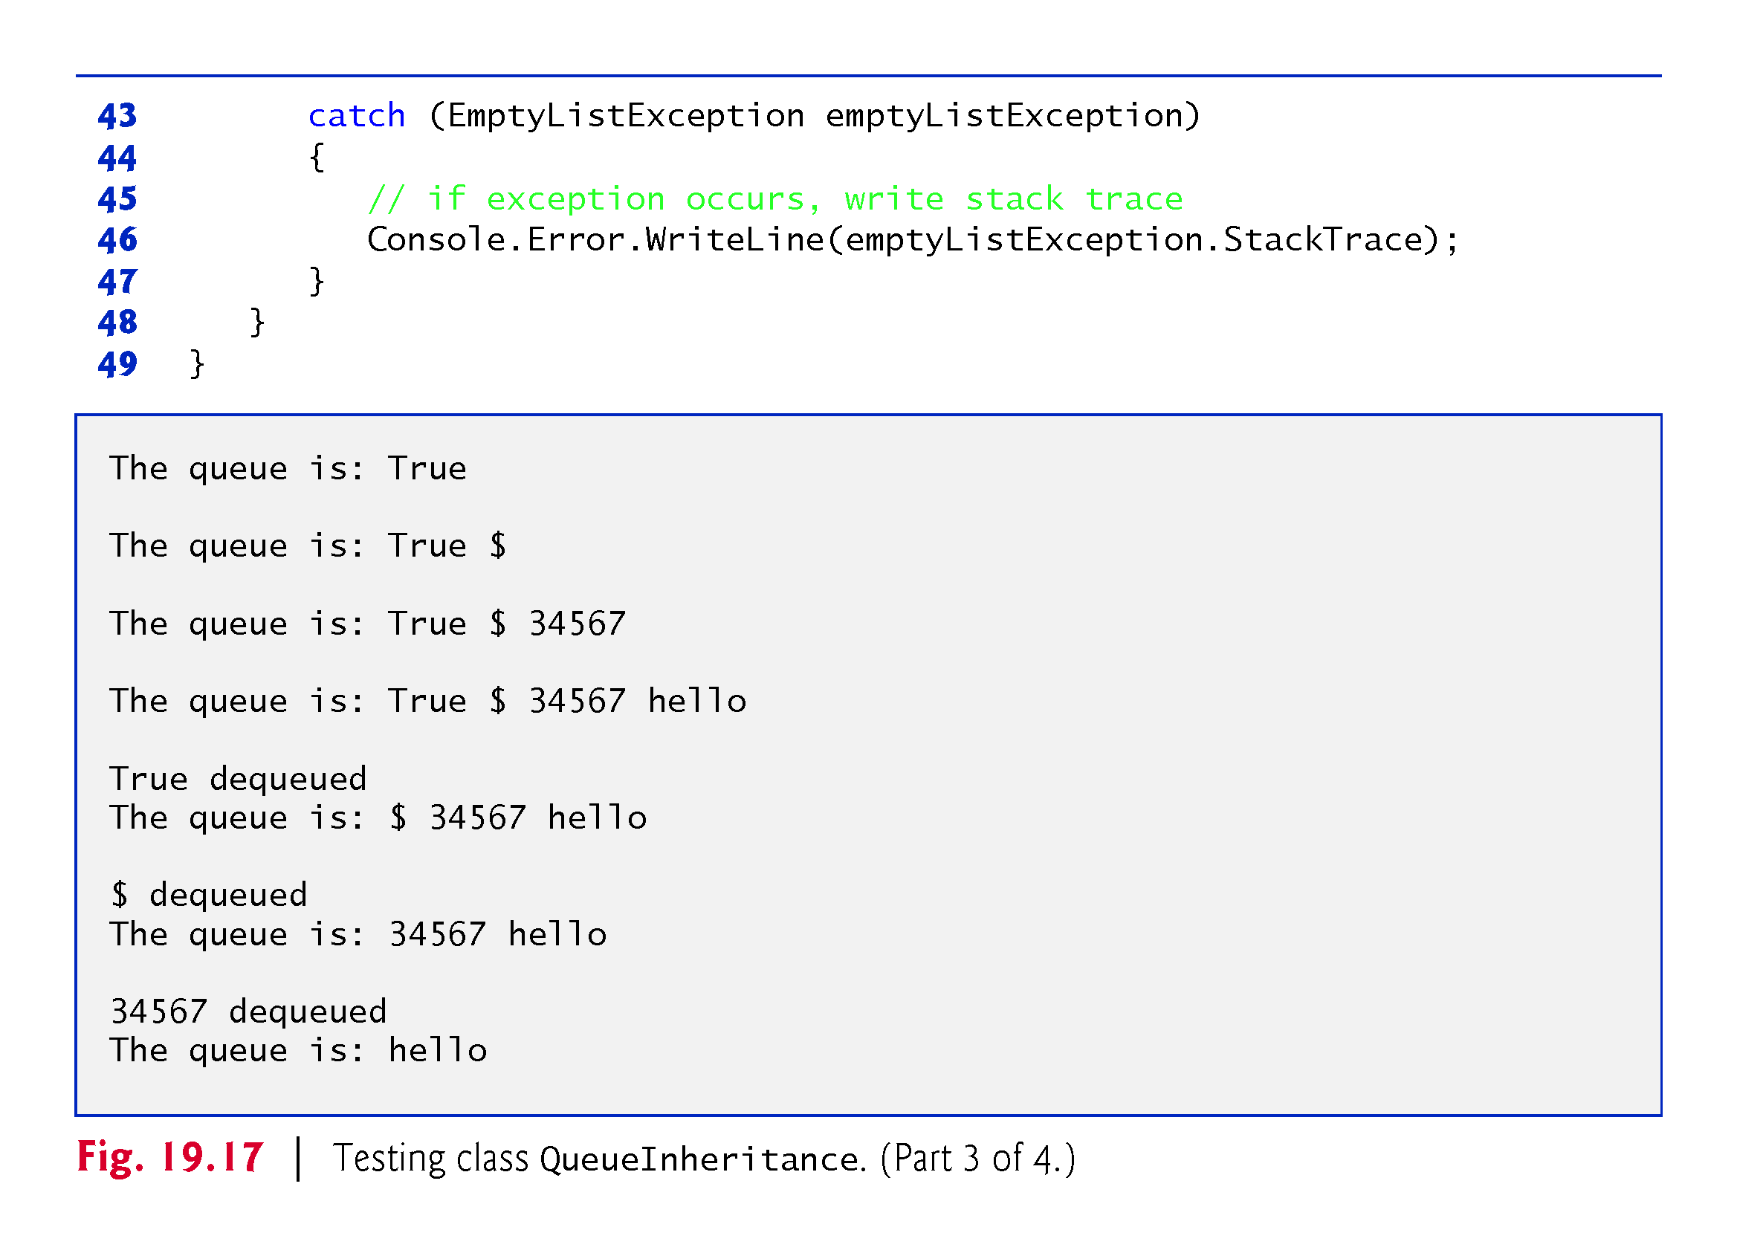

Slide 82
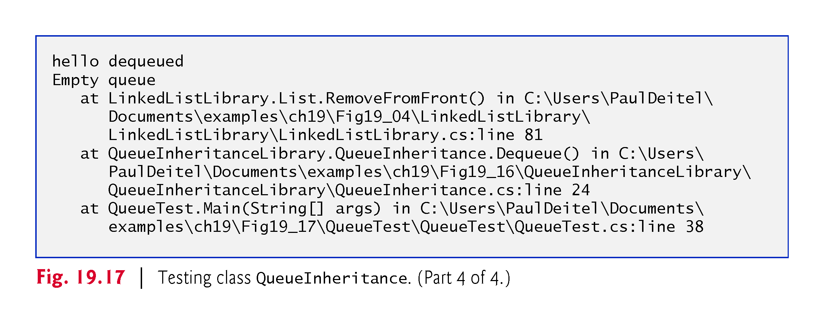

Slide 83
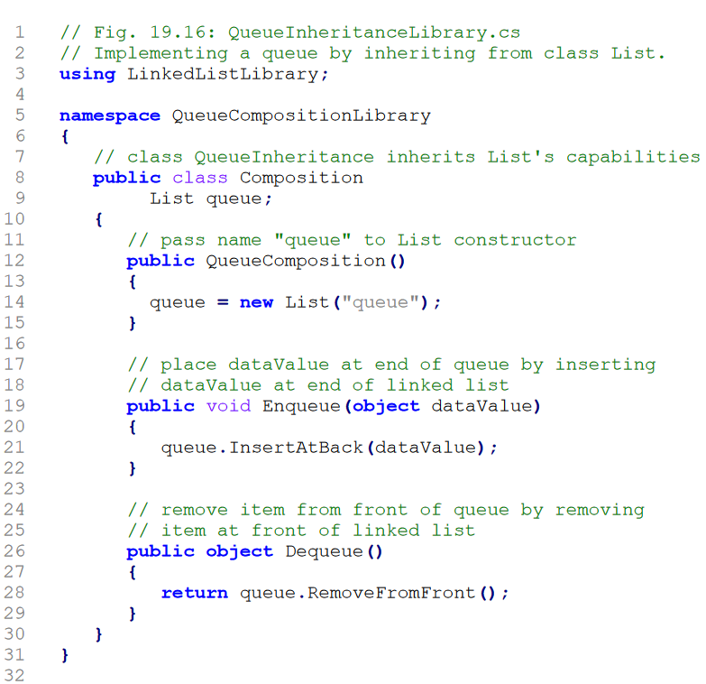

Slide 84
Q&A: Create Stack/Queue from existing class list by is/has(composition) relation

Slide 87
19.7 Trees
Linked lists, stacks and queues are linear data structures (i.e., sequences).
A tree is a nonlinear, two-dimensional data structure with special properties. Tree nodes contain two or more links.

Slide 88
19.7 Trees (cont.)
Basic Terminology
With binary trees (Fig. 19.18), each tree node contains two links (none, one or both of which may be null).
The root node is the first node in a tree.
Each link in the root node refers to a child.
The left child is the first node in the left subtree, and the right child is the first node in the right subtree.
The children of a specific node are called siblings.
A node with no children is called a leaf node.
Computer scientists normally draw trees from the root node down—the opposite of the way most trees grow in nature.

Slide 89
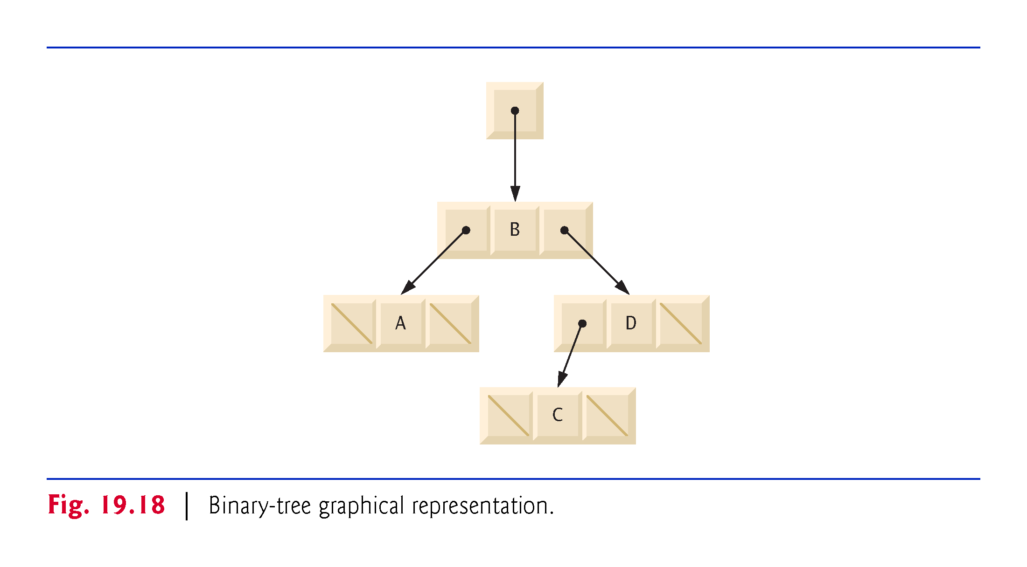

Slide 90
19.7 Trees (cont.)
Binary Search Trees
In our binary-tree example, we create a special binary tree called a binary search tree.
A binary search tree (with no duplicate node values) has the characteristic that the values in any left subtree are less than the value in the subtree’s parent node, and the values in any right subtree are greater than the value in the subtree’s parent node.
Figure 19.19 illustrates a binary search tree with integer values. The shape of the binary search tree that corresponds to a set of data can depend on the order in which the values are inserted into the tree.

Slide 91
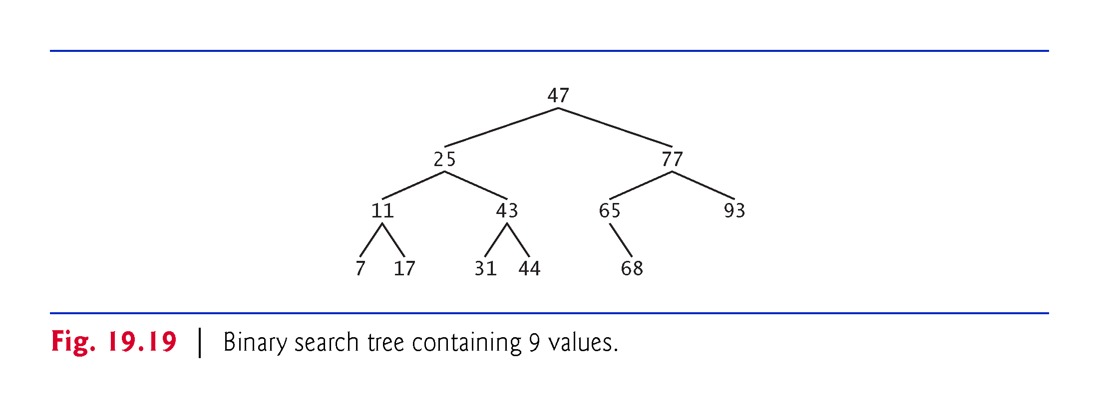

Slide 92
19.7 Trees (cont.)
The app of Figs. 19.20 and 19.21 creates a binary search tree of integers and traverses it (i.e., walks through all its nodes) in three ways—using recursive inorder, preorder and postorder traversals.

Slide 93
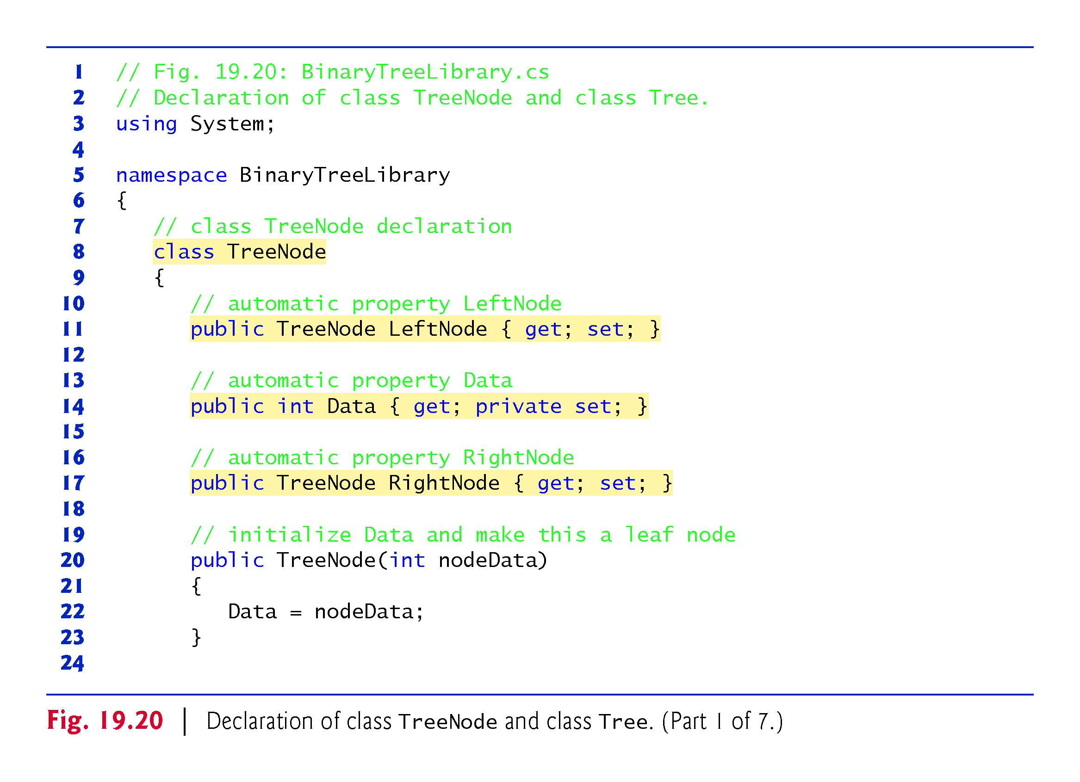

Slide 94
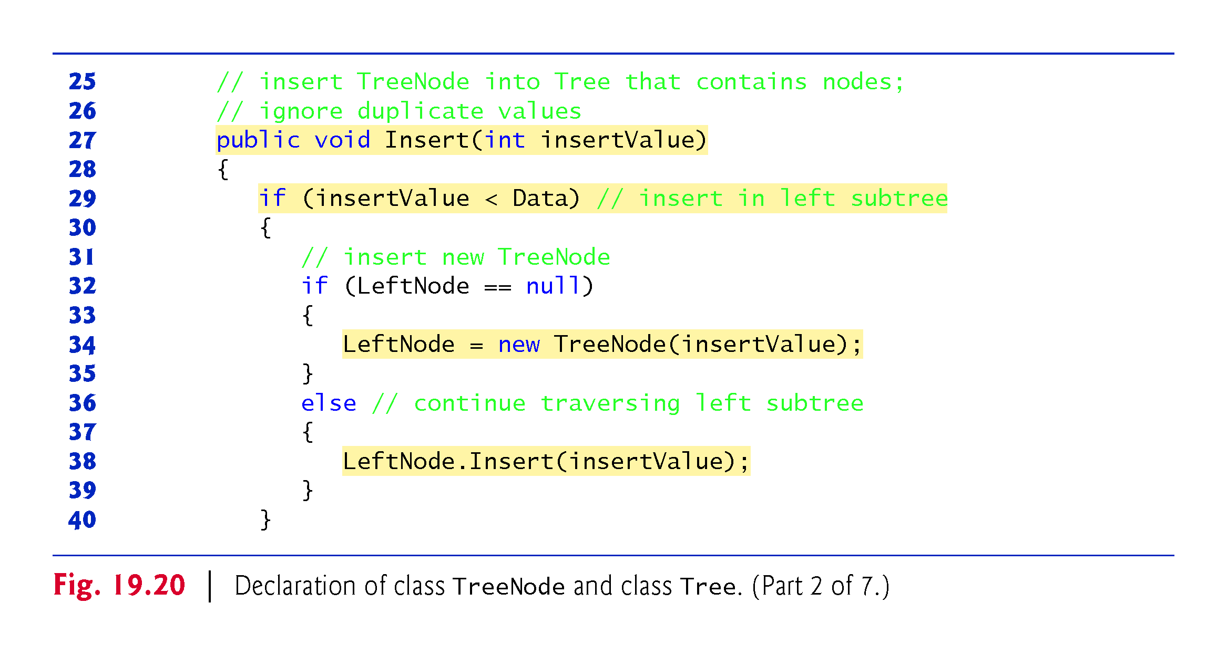

Slide 95


Slide 96


Slide 97


Slide 98


Slide 99


Slide 100


Slide 101


Slide 102


Slide 103
19.7 Trees (cont.)
For the following discussion, we use the binary search tree shown in Fig. 19.22.

Slide 104


Slide 105
19.7 Trees (cont.)
Inorder Traversal Algorithm
Method InorderHelper (lines 105–118) defines the steps for an inorder traversal.
Those steps are as follows:
If the argument is null, do not process the tree.
Traverse the left subtree with a call to InorderHelper
Process the value in the node
Traverse the right subtree with a call to InorderHelper

Slide 106
19.7 Trees (cont.)
The inorder traversal does not process the value in a node until the values in that node’s left subtree are processed. The inorder traversal of the tree in Fig. 19.22 is
6 13 17 27 33 42 48
The inorder traversal of a binary search tree displays the node values in ascending order.
The process of creating a binary search tree actually sorts the data (when coupled with an inorder traversal)—thus, this process is called the binary-tree sort.

Slide 107
19.7 Trees (cont.)
Preorder Traversal Algorithm
Method PreorderHelper (lines 83–96) defines the steps for a preorder traversal.
Those steps are as follows:
If the argument is null, do not process the tree.
Process the value in the node
Traverse the left subtree with a call to PreorderHelper
Traverse the right subtree with a call to PreorderHelper

Slide 108
19.7 Trees (cont.)
The preorder traversal processes the value in each node as the node is visited.
After processing the value in a given node, the preorder traversal processes the values in the left subtree, then the values in the right subtree.
The preorder traversal of the tree in Fig. 19.22 is
27 13 6 17 42 33 48

Slide 109
19.7 Trees (cont.)
Postorder Traversal Algorithm
Method PostorderHelper (lines 127-140) defines the steps for a postorder traversal.
Those steps are as follows:
If the argument is null, do not process the tree.
Traverse the left subtree with a call to PostorderHelper .
Traverse the right subtree with a call to PostorderHelper
Process the value in the node

Slide 110
19.7 Trees (cont.)
The postorder traversal processes the value in each node after the values of all that node’s children are processed.
The postorder traversal of the tree in Fig. 19.22 is
6 17 13 33 48 42 27

Slide 111
19.7 Trees (cont.)
Duplicate Elimination
A binary search tree facilitates duplicate elimination.
Searching a binary tree for a value that matches a key value is fast, especially for tightly packed binary trees.

Slide 112
19.7.2 Binary Search Tree of IComparable Objects
In our next example, we take advantage of C#’s polymorphic capabilities by implementing TreeNode and Tree classes that manipulate objects of any type that implements interface IComparable (namespace System).
It is imperative that we be able to compare objects stored in a binary search tree, so we can determine the path to the insertion point of a new node.
Classes that implement IComparable define method CompareTo, which compares the object that invokes the method with the object that the method receives as an argument.
Notes:
Imperative very important, critical

Slide 113
19.7.2 Binary Search Tree of IComparable Objects (cont.)
Figures 19.23–19.24 enhance the program of Section 19.7.1 to manipulate IComparable objects.
One restriction on the new versions of classes TreeNode and Tree is that each Tree object can contain objects of only one type (e.g., all strings or all doubles).
If a program attempts to insert multiple types in the same Tree object, ArgumentExceptions will occur.
We modified only five lines of code in class TreeNode (lines 14, 20, 27, 29 and 41 of Fig. 19.23) and one line of code in class Tree (line 64) to enable processing of IComparable objects.

Slide 114


Slide 115


Slide 116


Slide 117


Slide 118


Slide 119


Slide 120


Slide 121


Slide 122


Slide 123


Slide 124


Slide 125


